Slide 1
Broker Slides
Monthly Updates
February 2023

Slide 2
Table of Contents
Market Statistics 2022 - Year in Review
2022 Annual Report Summary
Area Overviews
Price Range Review
Closed Sales & Pending Sales Review
Median Sales Price – By County
3-11
Compliance
Updating Sales Information Best Practices
Adding Teams to a Closed Listing
Team Updates
12-14
SmartMLS Updates and Resources
New Beginnings With Purpose
SmartDesk Access
Hours of Operation
15-17

Slide 3
2022 Annual Report on the Connecticut Housing Market is Here
Summary: In 2022, Mortgage rates were near historic lows, buyer competition was fierce, and homes were selling at a breakneck pace, often with multiple bids and all-cash offers, due to pent-up demand and a shortage of housing supply, causing sales prices to soar to new heights.
But all that changed a few months later as mortgage rates began to rise, adding hundreds of dollars to monthly mortgage payments and causing housing affordability to plummet to its lowest level in decades. As borrowing costs continued to increase, home sales and home prices began to slow, and after two years of record-breaking activity, the red-hot housing market was finally cooling.
Scan the code for the entire SmartMLS report, or click the link HERE. For Board specific reports, please click HERE and select your designated area.
3

Slide 4
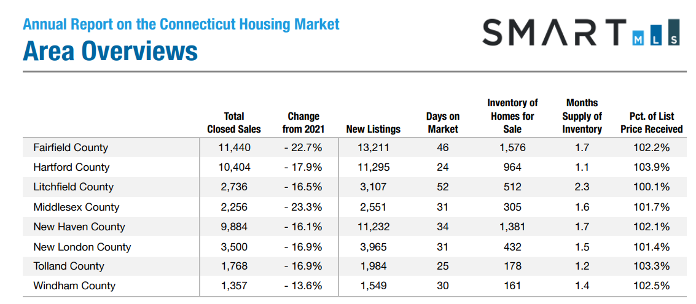
Note – This is Inclusive of Single-Family Homes & Townhouse/Condo Homes for the Entire State of Connecticut. Data Current as of January 8, 2023. Scan the code for the full report, or click HERE.
4

Slide 5
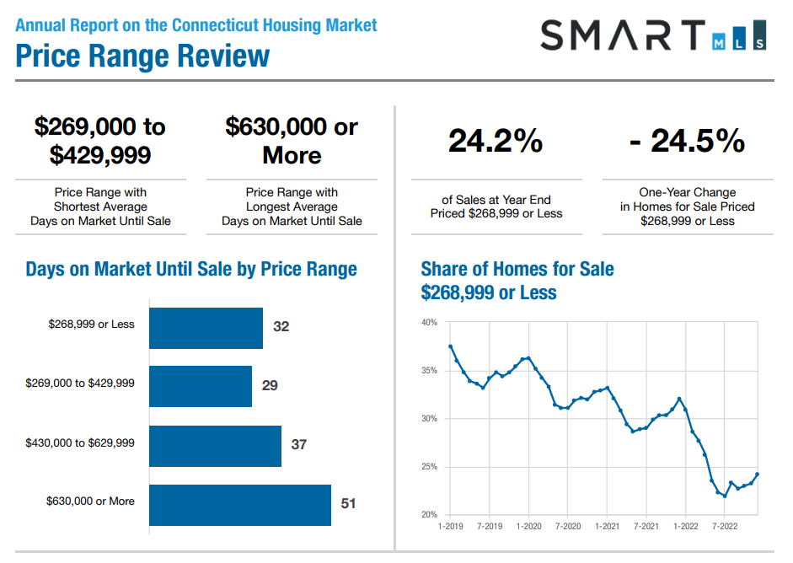
Note – This is Inclusive of Single-Family Homes & Townhouse/Condo Homes for the Entire State of Connecticut. Data Current as of January 8, 2023. Scan the code for the full report, or click HERE.
5

Slide 6
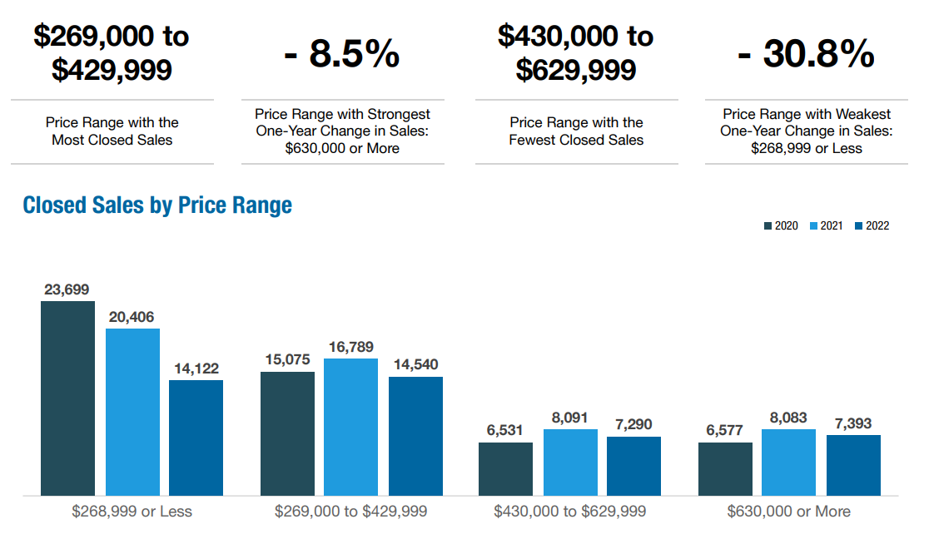
Annual Report on the Connecticut Housing Market
Price Range Review – Continued
6

Slide 7
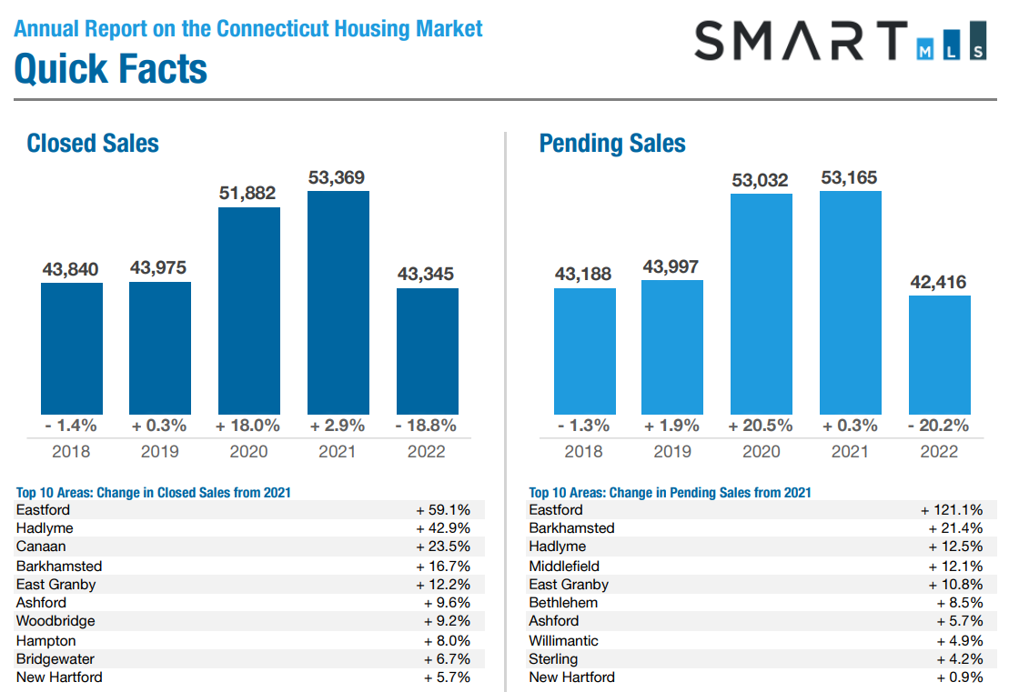
7

Slide 8
Median Sales Price – By County
Fairfield County
New Haven County
Month in 2022 | Single Family | Year-Over-Year Change | Townhouse/ Condo | Year-Over-Year Change
January | $550,000 | + 0.3% | $283,000 | + 2.9%
February | $572,000 | - 3.1% | $285,000 | + 11.3 %
March | $611,500 | + 11.2% | $322,500 | + 7.1%
April | $627,500 | + 3.9% | $315,222 | + 5.3%
May | $685,000 | 0.0% | $332,500 | + 11.0%
June | $750,000 | + 9.5% | $370,000 | + 12.1%
July | $692,500 | + 2.6% | $369,000 | + 23.0%
August | $700,000 | + 7.9% | $347,500 | + 13.9%
September | $630,000 | + 7.7% | $365,000 | + 23.8%
October | $630,000 | + 14.5% | $330,000 | + 4.6%
November | $630,000 | + 10.7% | $320,000 | + 4.9%
December | $591,500 | + 2.0% | $340,000 | + 9.7%
Median | $630,000 | +5.8% | $331,250 | +10.3%
Month in 2022 | Single Family | Year-Over-Year Change | Townhouse/ Condo | Year-Over-Year Change
January | $299,000 | + 10.8 | $186,968 | + 14.7%
February | $300,000 | + 11.1% | $175,000 | + 16.7%
March | $315,000 | + 9.4% | $174,000 | + 1.2%
April | $327,950 | + 13.1% | $190,000 | + 12.1%
May | $345,000 | + 14.2% | $205,000 | + 7.9%
June | $355,000 | + 10.9% | $213,000 | + 17.7%
July | $355,000 | + 9.2% | $215,000 | + 16.5%
August | $352,000 | + 11.7% | $211,950 | + 11.6%
September | $340,000 | + 13.3% | $199,900 | + 11.1%
October | $340,000 | + 11.5% | $210,000 | + 10.4%
November | $329,950 | + 6.4% | $205,000 | + 9.6%
December | $306,000 | + 2.0% | $205,000 | + 13.9
Median | $334,975 | + 11.0% | $205,000 | + 11.9%
Data Current as of January 10th , 2023.
Click Here to Access Fairfield County Full Report
Click Here to Access New Haven County Full Report
8

Slide 9
Median Sales Price – By County
Lichfield County
Hartford County
Month in 2022 | Single Family | Year-Over-Year Change | Townhouse/ Condo | Year-Over-Year Change
January | $338,000 | + 5.6% | $150,000 | + 21.0%
February | $325,900 | + 3.3% | $190,000 | + 58.3%
March | $320,100 | + 3.3% | $188,750 | + 28.0%
April | $408,000 | + 26.7% | $165,125 | + 33.7%
May | $340,000 | 0.0% | $191,900 | + 26.3%
June | $335,000 | + 1.5% | $162,500 | + 14.8%
July | $359,950 | + 8.7% | $184,505 | + 12.5%
August | $359,500 | + 12.8% | $171,000 | + 17.1%
September | $330,500 | + 4.7% | $175,000 | + 16.7%
October | $345,000 | + 11.3% | $145,000 | - 2.2%
November | $355,000 | + 11.8% | $190,100 | + 6.2%
December | $331,000 | - 0.5% | $172,500 | + 16.6%
Median | $339,000 | 5.2% | $173,750 | + 16.9%
Month in 2022 | Single Family | Year-Over-Year Change | Townhouse/ Condo | Year-Over-Year Change
January | $275,000 | + 2.3% | $181,000 | + 2.8%
February | $275,000 | + 2.7% | $173,000 | + 8.1%
March | $291,000 | + 9.8% | $180,000 | + 3.5%
April | $310,000 | + 9.2% | $200,000 | + 14.1%
May | $326,000 | + 14.4% | $208,500 | + 19.1%
June | $335,000 | + 11.7% | $231,000 | + 24.9%
July | $345,000 | + 9.5% | $210,000 | + 8.5%
August | $335,000 | + 7.4% | $214,000 | + 15.7%
September | $320,000 | + 10.5% | $210,000 | + 16.0%
October | $315,000 | + 12.5% | $225,000 | + 24.7%
November | $305,000 | + 5.5% | $214,000 | + 18.2%
December | $295,000 | + 3.8% | $202,750 | +9.6%
Median | $312,500 | + 9.3% | $209,250 | + 14.9%
Data Current as of January 10th , 2023.
Click Here to Access Lichfield County Full Report
Click Here to Access Hartford County Full Report
9

Slide 10
Median Sales Price – By County
Middlesex County
New London County
Month in 2022 | Single Family | Year-Over-Year Change | Townhouse/ Condo | Year-Over-Year Change
January | $339,000 | + 9.0% | $170,000 | + 23.3%
February | $345,000 | + 1.5% | $187,000 | + 22.7%
March | $370,000 | + 12.1% | $150,500 | + 3.9%
April | $379,250 | + 13.2% | $166,000 | - 2.9%
May | $374,900 | + 8.7% | $168,000 | - 11.5%
June | $400,000 | + 15.3% | $205,000 | + 10.1%
July | $384,950 | + 4.1% | $185,000 | + 17.8%
August | $380,000 | + 11.7% | $194,950 | + 14.7%
September | $390,000 | + 8.3% | $193,000 | + 10.9%
October | $375,000 | 0.0% | $180,000 | + 11.8%
November | $385,000 | + 9.2% | $205,000 | + 18.8%
December | $385,000 | + 7.5% | $197,500 | + 5.1%
Median | $379,625 | + 8.8% | $186,000 | + 11.4%
Month in 2022 | Single Family | Year-Over-Year Change | Townhouse/ Condo | Year-Over-Year Change
January | $305,000 | + 13.0% | $165,000 | + 12.5%
February | $299,000 | + 9.9% | $178,000 | - 4.8%
March | $312,000 | + 15.6% | $185,000 | + 25.0%
April | $323,500 | + 3.4% | $180,000 | - 7.7%
May | $322,000 | + 11.0% | $185,000 | + 18.5%
June | $341,500 | + 10.2% | $190,000 | + 6.7%
July | $340,000 | + 11.5% | $202,250 | + 39.0%
August | $340,000 | + 7.9% | $194,500 | + 9.3%
September | $331,250 | + 3.5% | $217,000 | + 20.6%
October | $340,000 | + 13.3% | $215,000 | + 24.3%
November | $315,000 | + 5.5% | $170,450 | - 5.3%
December | $313,500 | - 1.4% | $180,500 | + 5.1%
Median | $322,750 | + 10.0% | $185,000 | + 10.9%
Data Current as of January 10th , 2023.
Click Here to Access Middlesex County Full Report
Click Here to Access New London County Full Report
10

Slide 11
Median Sales Price – By County
Tolland County
Windham County
Month in 2022 | Single Family | Year-Over-Year Change | Townhouse/ Condo | Year-Over-Year Change
January | $300,000 | + 3.8% | $160,000 | + 26.0%
February | $270,000 | + 3.8% | $184,250 | + 53.5%
March | $285,000 | + 9.6% | $169,950 | + 13.4%
April | $310,000 | + 8.8% | $177,500 | + 34.5%
May | $322,750 | + 9.4% | $155,000 | - 43.6%
June | $333,050 | + 1.7% | $194,000 | + 28.5%
July | $340,000 | + 7.9% | $153,000 | - 2.3%
August | $328,000 | + 4.1% | $190,500 | + 30.0%
September | $320,000 | + 4.4% | $155,000 | + 19.2%
October | $320,000 | + 8.5% | $160,000 | + 18.5%
November | $322,500 | + 7.5% | $177,500 | + 34.0%
December | $310,000 | + 8.8% | $233,950 | + 50.5%
Median | $320,000 | + 7.7% | $173,725 | + 27.2%
Month in 2022 | Single Family | Year-Over-Year Change | Townhouse/ Condo | Year-Over-Year Change
January | $285,000 | + 14.0% | $212,500 | + 61.6%
February | $265,000 | + 6.0% | $235,000 | + 35.8%
March | $267,250 | - 1.9% | $207,500 | - 9.7%
April | $300,000 | + 10.1% | $173,750 | - 3.5%
May | $320,000 | + 18.5% | $213,750 | + 33.6%
June | $303,000 | + 13.9% | $299,500 | + 28.8%
July | $315,000 | + 16.9% | $210,000 | + 25.4%
August | $317,000 | + 15.3% | $225,000 | - 2.6%
September | $298,000 | + 2.8% | $245,000 | + 39.2%
October | $305,000 | + 11.9% | $175,000 | - 22.4%
November | $278,475 | - 3.3% | $235,000 | + 23.7%
December | $290,000 | + 1.4% | $150,000 | - 15.4%
Median | $299,000 | + 11.0% | $213,125 | +24.5%
Data Current as of January 10th , 2023.
Click Here to Access Tolland County Full Report
Click Here to Access Windham County Full Report
11

Slide 12
Compliance Updates
Listing Agreements –
SMARTMLS Rules and Regulations state that you have 24 hours from activation to upload the executed Listing Agreement or Listing Agreement Compliance Certification. However, you must have a fully executed, signed listing agreement before entering a property as Active or Coming Soon. The 24 hours to get the form uploaded is simply a courtesy we afford the listing agent.
Signatures of all parties to a listing agreement must be obtained before any advertising/marketing of a property can happen. Placing a property on the MLS is advertising/marketing/promotion.
The wording that agents use in the Remarks sections of their listings is intellectual property and consequently protected by creative license and copyright law. Copying it, either loosely or verbatim, without express written permission from the author is strictly prohibited.
12

Slide 13
Compliance Updates
Teams – Adding Teams to Closed Listing
All members must be registered with the DCP and be active members of SmartMLS. We have received several inquiries requesting that a Team ID be added to the sales side of closed listings. If a request comes in and the team member is not listed on DCP, SmartMLS will not add that Team ID to the closed listings, even if the agent is added after the fact.
SmartMLS timestamps the records from DCP showing the full list of agents registered with any team. Any agent added to the team after the listing has closed in SmartMLS will not qualify to have the TEAM ID added to those closed listings, as the agent was not a registered member of the team on DCP prior to the listing closing.
To add or remove members to a team in Matrix, please reach out to our Membership Team via email Membership@smartmls.com or calling 203-7540-6000, option 2.
For more information on teams and to register team members with the state, please reach out to DCP directly or click the following link:
https://portal.ct.gov/DCP/License-Services-Division/All-License-Applications/Real-Estate-Teams
13

Slide 14
Compliance Updates
If a listing is missing Agent or Team information or the listing is closed out with the wrong Sales Agent/Office/Team information, SmartMLS Compliance staff are the only ones who can correct the information.
We can only make these types of changes over the phone if the list agent/Broker/Admin is the one requesting the change.
Note: To maintain efficiency and accuracy, we only make corrections over the phone for individual listings.
We will not make changes to the Sales Agent/Office/Team information on a listing that closed more than 1 year (365 days) from the current date.
14

Slide 15
PLAN FOR THE FUTURE Trust, Cooperation, and Market Information Everyone Can Count On. Servicing Connecticut With You in Mind.
15

Slide 16
New Beginnings With Purpose
SmartMLS is here to guide you through a series of changes to our platform. With step-by-step inclusive guidance and a new outlook on the 2023 market ahead, we will elevate your business by creating a streamlined approach to the end-user experience.
Please read correspondences from SmartMLS in the future, as we will provide further details as products develop.
We look forward to hearing your feedback and delivering a beneficial, productive marketplace – just for you.
16

Slide 17
Need Help with Something Else?
Access our 24/7 SmartDesk HERE for answers to common questions. You can also utilize our chat feature by clicking this icon located on the bottom right corner of the SmartDesk screen.
Contact SmartMLS with assistance on Compliance, Technical Support, or Membership Questions:
203-750-6000
Support@Smartmls.com
Hours of Operation:
Monday - Thursday 8:30am-7:00pm
Friday – 8:30am – 6:00pm
Weekends – 9am – 3:00pm
17

