Slide 1
Broker Slides
Monthly Updates
April 2023

Slide 2
Table of Contents
News and Alerts - SmartTax Introduction
SmartTax Overview
Prospecting in SmartTax
SmartTax Access and Help
3 - 8
Market Statistics – February 2023
Residential Overview
Local Market Updates – By County
Single – Family
Townhouse/ Condos
Rental Report – By County
9 - 12
13
Compliance
Uploading Listing Agreements
SmartMLS Updates and Resources
SmartDesk Access
Hours of Operation
14

Slide 3
PLAN FOR THE FUTURE Trust, Cooperation, and Market Information Everyone Can Count On. Servicing Connecticut With You in Mind.
3

Slide 4
New Beginnings With Purpose
SmartMLS is here to guide you through a series of changes to our platform. With step-by-step inclusive guidance and a new outlook on the 2023 market ahead, we will elevate your business by creating a streamlined approach to the end-user experience.
Please read the following correspondences, as these brand-new additions to our platform directly affect you.
We look forward to hearing your feedback and working to ensure a favorable management system and delivering a beneficial, productive marketplace – just for you.
4

Slide 5
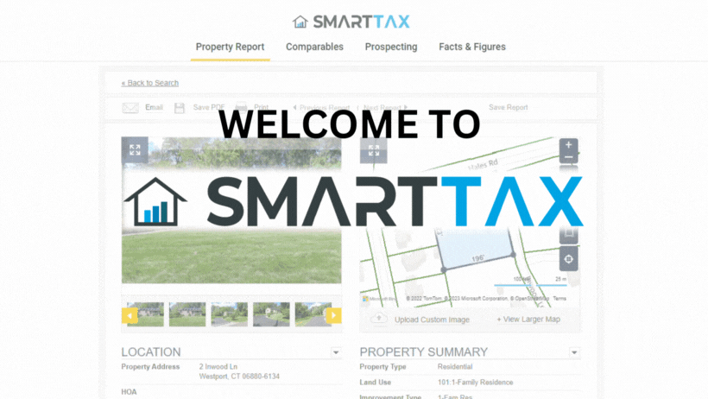
5

Slide 6
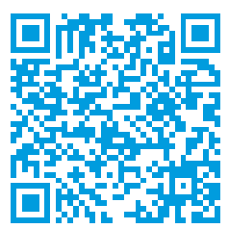
SmartTax Overview
The SmartTax system is a customizable records system that brings information into one dynamic program. In addition to delivering robust public tax information for all 169 Connecticut municipalities, the SmartTax system provides access to sales & mortgage histories, warranty deeds, interactive GIS plat maps, area demographics, and more.
Here are some ways to best utilize SmartTax:
Generate quick or advanced comparable reports
Create a farm area by selecting criteria(s) and exporting/printing mailing labels
Work from anywhere with full mobile access and functionality
Create and save custom public records searches and reports
Brand SmartTax with personal preferences
Scan the QR code for access to the Smartdesk information on SmartTax.
6

Slide 7
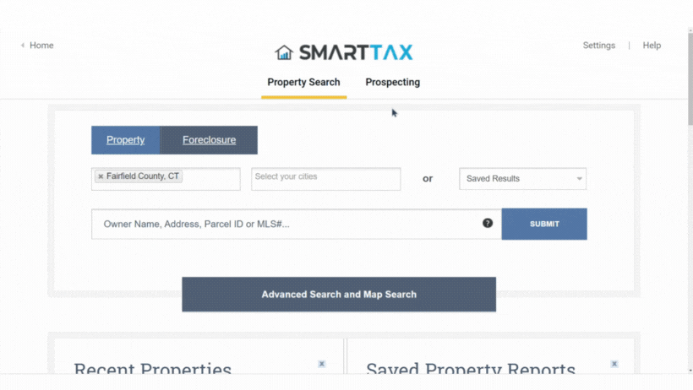
Prospecting in SmartTax
The Prospecting Search Screen Provides:
17 search filters, located on the left column.
Intuitive Legend for Property Statuses (For Sale, Sold, etc.)
“Create Label Options” - Avery label printing capabilities.
“Prospecting Report Options” - Export to CSV files for your database.
Accurate property owner information and current mailing addresses
Custom saved searches
7
Scan the QR Code for More Information on SmartTax Prospecting

Slide 8
SmartTax Training & Help
Here are live training sessions, available via Zoom in the training section on SmartMLS Homepage:
Here is a list of helpful guides containing a more in-depth look at SmartTax:
SmartTax Property Report
SmartTax Custom Exports
Customizing SmartTax Property Reports
SmartTax ProspectingCreating Mailing Labels in SmartTax
Don’t forget to visit our SmartTax Product Page. We value your input and would love to hear your feedback.
As always, we’re here to help you every step of the way. We can’t wait for you to experience SmartTax!
Scan the QR code for additional Smartdesk information on SmartTax.
Overview of SmartTax | Morning Sessions | Afternoon Sessions
April 6th 2023 | 10:00am – 11:30am | 2:00pm – 3:30pm
April 13th 2023 | 9:30am – 10:30am
April 26th 2023 | 10:00am – 11:30am | 2:00pm – 3:30pm
8

Slide 9
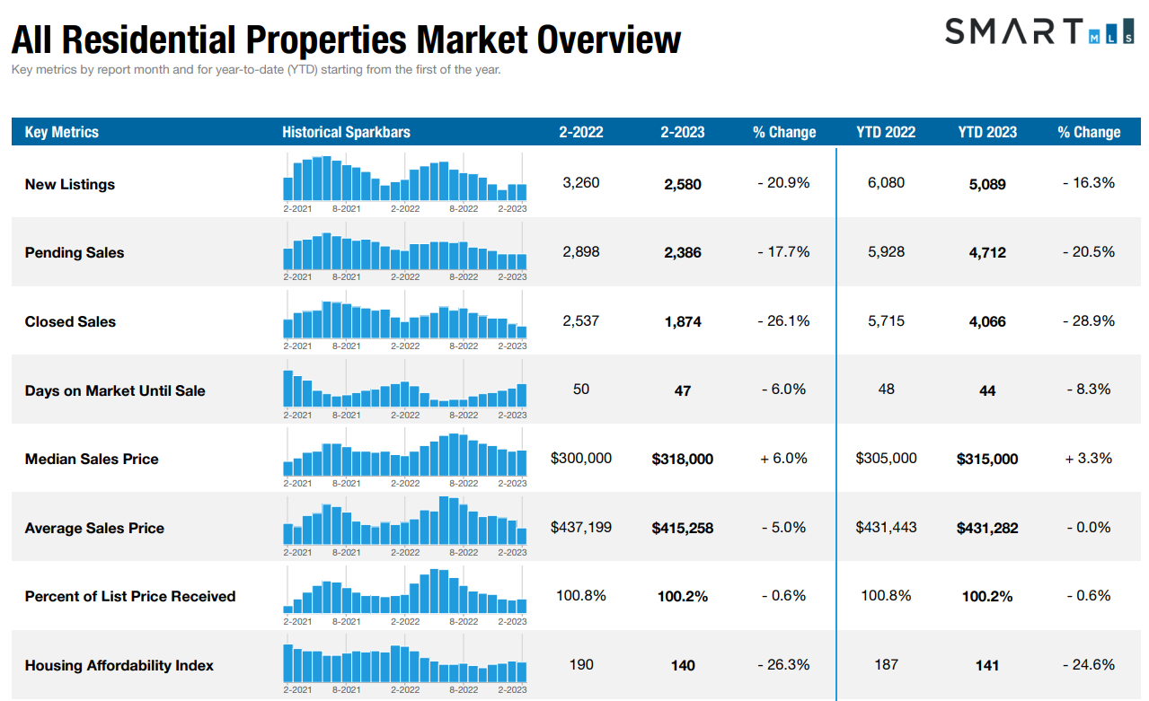
CLICK HERE the full overview of Connecticut Metrics
9
The following data is current as of March 8, 2023. All data from SmartMLS. Report © 2023 ShowingTime

Slide 10
Single - Family Market Updates – By County
County | Number of New Listings (Feb 2022) | Number of New Listings (Feb 2023) | Percent Change | Closed Sales (Feb 2022) | Closed Sales (Feb 2023) | Percent Change | Average Sales Price (Feb 2022) | Average Sales Price (Feb 2023) | Percent Change
Fairfield | 704 | 510 | - 27.6% | 465 | 295 | - 36.6% | $903,577 | $792,264 | -3.7%
Hartford | 588 | 462 | - 21.4% | 464 | 350 | - 24.6% | $325,683 | $342,873 | + 5.3%
Lichfield | 153 | 139 | - 9.2% | 125 | 100 | - 20.0% | $448,490 | $441,768 | - 1.5%
Middlesex | 125 | 116 | - 7.2% | 97 | 88 | - 9.3% | $451,315 | $451,813 | + 0.1%
New Haven | 543 | 441 | - 18.8% | 438 | 335 | - 23.5% | $387,097 | $364,540 | - 5.8%
New London | 209 | 142 | -32.1% | 162 | 142 | -12.3 % | $ 366,490 | $382,037 | + 4.2%
Tolland | 106 | 83 | - 21.7% | 93 | 81 | - 12.9% | $326, 996 | $ 341,482 | +4.4%
Windham | 81 | 74 | - 8.6% | 82 | 57 | - 30.5% | $290,465 | $329,347 | + 13.4%
10
The following data is current as of March 8, 2023. All data from SmartMLS. Report © 2023 ShowingTime

Slide 11
Condo/Townhouse Market Updates – By County
County | Number of New Listings (Feb 2022) | Number of New Listings (Feb 2023) | Percent Change | Closed Sales (Feb 2022) | Closed Sales (Feb 2023) | Percent Change | Average Sales Price (Feb 2022) | Average Sales Price (Feb 2023) | Percent Change
Fairfield | 249 | 237 | - 4.8% | 209 | 134 | - 35.9% | $341,255 | $385,952 | + 13.1%
Hartford | 171 | 123 | - 28.1% | 137 | 108 | - 21.2% | $204,459 | $231,327 | + 13.1%
Lichfield | 24 | 14 | - 41.7% | 35 | 23 | - 34.3% | $246,085 | $194,452 | - 21.0%
Middlesex | 46 | 26 | - 43.5% | 30 | 19 | - 36.7% | $247,813 | $273,246 | + 10.3%
New Haven | 203 | 181 | - 10.8% | 161 | 121 | - 24.8% | $213,868 | $240,503 | + 12.5%
New London | 50 | 28 | - 44.0% | 34 | 28 | - 17.6% | $192,800 | $294,659 | +52.8%
Tolland | 19 | 10 | - 47.4 % | 21 | 12 | - 42.9% | $213,897 | $229,680 | + 7.4%
Windham | 8 | 4 | - 50.0% | 3 | 5 | + 66.7% | $269,505 | $261,400 | - 3.0%
11
The following data is current as of March 8, 2023. All data from SmartMLS. Report © 2023 ShowingTime

Slide 12
Rental Market Updates – By County
County | Number of Active Rentals (Feb 2022) | Number of Active Rentals (Feb 2023) | Percent Change | Number of Properties Leased (Feb 2022) | Number of Properties Leased (Feb 2023) | Percent Change | Average Monthly Lease Price (Feb 2022) | Average Monthly Lease Price (Feb 2023) | Percent Change
Fairfield | 846 | 1,125 | + 33.0% | 304 | 347 | + 14.1% | $3,486 | $3,414 | - 2.0%
Hartford | 474 | 623 | + 67.6% | 111 | 186 | + 67.6% | $1,638 | $1,682 | + 2.7%
Lichfield | 217 | 296 | + 36.4% | 44 | 61 | + 38.6% | $5,551 | $3,505 | - 36.9%
Middlesex | 123 | 191 | + 55.3% | 32 | 40 | + 25.0% | $1,973 | $1,582 | - 19.8%
New Haven | 496 | 754 | + 52.0% | 189 | 193 | + 2.1% | $1,821 | $1,985 | + 9.0%
New London | 268 | 292 | + 9.0% | 55 | 81 | + 47.3% | $1,793 | $1,703 | - 5.0%
Tolland | 94 | 84 | - 10.6% | 15 | 13 | - 13.3% | $1,585 | $1,827 | + 15.2%
Windham | 54 | 55 | + 1.9% | 6 | 9 | + 50.0% | $1,267 | $1,596 | + 26.0%
12
The following data is current as of March 8, 2023. All data from SmartMLS. Report © 2023 ShowingTime

Slide 13
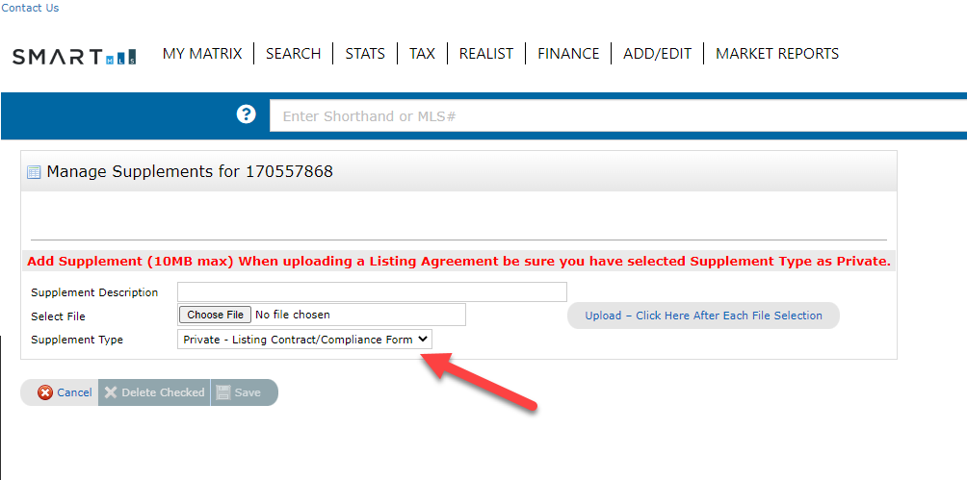
Compliance Updates – Uploading Listing Agreements
Beginning Monday, April 17, 2023, it is required to upload a copy of either your Listing Agreement or the Listing Agreement Compliance Certification before you will be able to activate a new listing.
The required paperwork must be uploaded while the listing is in the Incomplete status.
13

Slide 14
Need Help with Something Else?
Access our 24/7 SmartDesk HERE for answers to common questions. You can also utilize our chat feature by clicking this icon located on the bottom right corner of the SmartDesk screen.
Contact SmartMLS with assistance on Compliance, Technical Support, or Membership Questions:
203-750-6000
Support@Smartmls.com
Hours of Operation:
Monday - Thursday 8:30am-7:00pm
Friday – 8:30am – 6:00pm
Weekends – 9:00am – 3:00pm
14

