Slide 1
Broker Slides
Monthly Updates
March 2023

Slide 2
Table of Contents
News and Alerts - SmartTax Introduction
3
Market Statistics - January 2023
Exclusive Summary of Market Statistics
Local Market Updates – By County
Single – Family
Townhouse/ Condos
Rental Report – By County
4-8
Compliance
How to Fix Tax Record Errors
Coming Soon Listings – Information and Best Uses
9 -10
SmartMLS Updates and Resources
SmartDesk Access
Hours of Operation
11-13

Slide 3
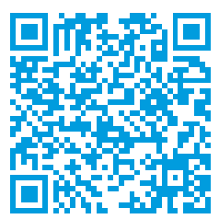
News and Alerts – SmartTax Introduction
Welcome to SmartTax, our new home for user-friendly public records and prospecting. We proudly introduce this addition to SmartMLS products.
The SmartTax system is a customizable records system that brings information into one dynamic program. In addition to delivering robust public tax information for all 169 Connecticut municipalities, the SmartTax system provides access to sales and mortgage histories, warranty deeds, interactive GIS plat maps, area demographics, and more.
Here are some ways to best utilize SmartTax:
Generate quick or advanced comparable reports
Export and print mailing labels
Work from anywhere with full mobile access and functionality
Create and save custom public records searches and reports
Branding with personal preferences
Scan the below QR code to access to the SmartDesk information on SmartTax.
3

Slide 4
Market Update – Connecticut Overview
The U.S. housing market began the year in a state of rebalance, with many buyers and sellers remaining cautious while they wait to see where the market is headed.
Seller concessions have made a comeback, giving buyers more time and negotiating power when shopping for a home.
Mortgage rates declined steadily throughout January, falling to their lowest level since September 2022. Lower rates should aid in affordability and may soon lead to an uptick in market activity ahead of the spring selling season.
Here are some January highlights:
Median Sales Price increased 1.5% to $339,950 for Single Family homes and 9.8% to $225,000 for Townhouse/Condo homes.
Days on Market decreased 10.6% for Single Family homes and 8.7 % for Townhouse/Condo homes.
CLICK HERE review the full overview of Connecticut Metrics.
The following data is current as of February 8, 2023. All data from SmartMLS. Report © 2023 ShowingTime
4

Slide 5
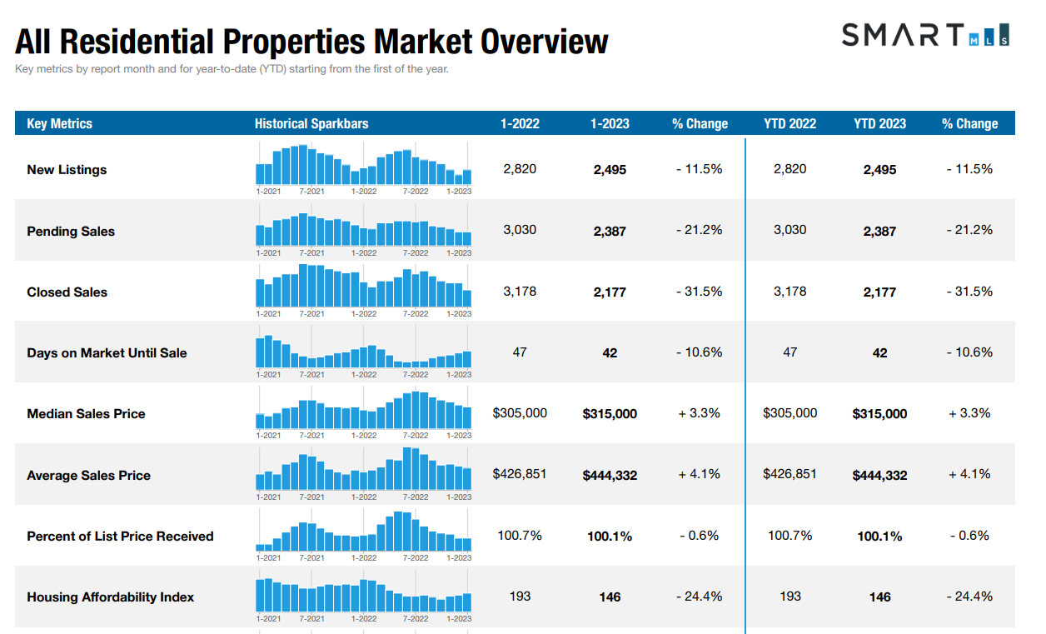
5

Slide 6
Single - Family Market Updates – By County
County | Number of New Listings (Jan 2022) | Number of New Listings (Jan 2023) | Percent Change | Closed Sales (Jan 2022) | Closed Sales (Jan 2023) | Percent Change | Average Sales Price (Jan 2022) | Average Sales Price (Jan 2023) | Percent Change
Fairfield | 534 | 474 | - 11.2% | 605 | 364 | - 39.8% | $859,181 | $897,254 | + 4.4%
Hartford | 477 | 415 | - 13.0% | 610 | 414 | - 32.1% | $311,589 | $350,584 | + 12.5%
Litchfield | 158 | 116 | - 26.6% | 172 | 120 | - 30.2% | $458,376 | $471,477 | + 2.9%
Middlesex | 104 | 96 | - 7.7% | 117 | 70 | - 40.2% | $380,997 | $489,896 | + 28.6%
New Haven | 490 | 439 | - 10.4% | 551 | 403 | - 26.9% | $359,526 | $358,095 | - 0.4%
New London | 153 | 188 | + 22.9% | 225 | 145 | - 35.6% | $ 336,450 | $352,471 | + 4.8%
Tolland | 106 | 83 | - 21.7% | 93 | 81 | - 12.9% | $326, 996 | $ 341,482 | +4.4%
Windham | 88 | 78 | - 11.4% | 86 | 72 | - 16.3% | $299,549 | $317,397 | + 6.0%
6

Slide 7
Condo/Townhouse Market Updates – By County
County | Number of New Listings (Jan 2022) | Number of New Listings (Jan 2023) | Percent Change | Closed Sales (Jan 2022) | Closed Sales (Jan 2023) | Percent Change | Average Sales Price (Jan 2022) | Average Sales Price (Jan 2023) | Percent Change
Fairfield | 250 | 206 | - 17.6% | 253 | 171 | - 32.4% | $386,613 | $467,453 | + 20.9%
Hartford | 175 | 140 | - 20.0% | 173 | 116 | - 32.9% | $200,721 | $224,965 | + 12.1%
Litchfield | 25 | 14 | - 44.0% | 31 | 28 | - 9.7% | $175,019 | $193,986 | + 10.8%
Middlesex | 27 | 32 | + 18.5% | 31 | 25 | - 19.4 % | $199,806 | $191,970 | - 3.9%
New Haven | 160 | 169 | + 5.6% | 170 | 124 | - 27.1% | $220,343 | $241,803 | + 9.7%
New London | 47 | 30 | - 36.2% | 36 | 29 | - 19.4% | $192,800 | $294,659 | +52.8%
Tolland | 19 | 10 | - 47.4 % | 21 | 12 | - 42.9% | $171,555 | $243,081 | + 41.7%
Windham | 7 | 5 | - 28.6% | 4 | 3 | - 25.0% | $245,951 | $263,000 | + 6.9%
7

Slide 8
Rental Market Updates – By County
County | Number of Active Rentals (Jan 2022) | Number of Active Rentals (Jan 2023) | Percent Change | Number of Properties Leased (Jan 2022) | Number of Properties Leased (Jan 2023) | Percent Change | Average Monthly Lease Price (Jan 2022) | Average Monthly Lease Price (Jan 2023) | Percent Change
Fairfield | 787 | 1,071 | + 36.1% | 272 | 370 | + 36.0% | $3,192 | $3,360 | + 5.2%
Hartford | 462 | 608 | + 31.6% | 110 | 175 | + 59.1% | $1,523 | $1,812 | + 19.0%
Litchfield | 188 | 285 | + 51.6% | 41 | 63 | + 53.7% | $3,797 | $3,555 | - 6.4%
Middlesex | 116 | 195 | + 68.1% | 26 | 35 | + 34.6% | $1,509 | $1,673 | + 10.9%
New Haven | 580 | 760 | + 31.0% | 181 | 179 | - 1.1% | $1,753 | $1,922 | + 9.7%
New London | 274 | 309 | + 12.8% | 66 | 70 | + 6.1% | $1,449 | $1,709 | + 17.9%
Tolland | 82 | 84 | + 2.4% | 11 | 12 | + 9.1% | $1,300 | $1,526 | + 17.4%
Windham | 43 | 45 | + 4.7% | 9 | 7 | - 22.7% | $2,181 | $1,039 | - 52.4%
8

Slide 9
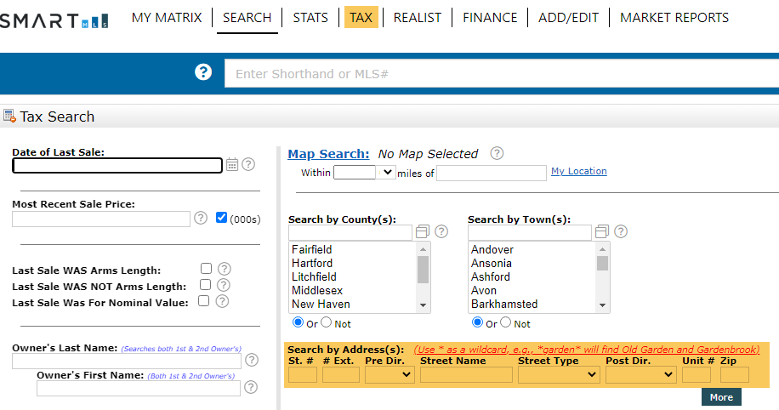
Compliance Updates - How to Fix Tax Record Errors
Step 1:
Have you noticed an error with a SmartMLS public record while entering a listing?
Step 1 - Go to “Tax” tab on your top toolbar and search the address.
Step 2 - Click “Report Inaccurate Tax Data.”
Click Submit when you’re done. This will send the data error report to our tax vendor, The Warren Group, for investigation and resolution.
The Warren Group researches the issue with town hall & updates the tax record. The tax update/corrections file is uploaded to the Matrix system once a week.
Once the error has been reported, the process takes a minimum of 10-15 business days to be corrected on Matrix.
Step 2:
9

Slide 10
Compliance – Coming Soon Rule
Important - Coming Soon Rule
Per Section 4.26 of our Rules & Regulations, you cannot enter a property as a Coming Soon listing unless it has been off the market for 90 days. The following actions are in violation of the Coming Soon Rules, and are subject to fines set forth in Attachment A:
Cancellation of a Coming Soon, and immediately re-listing it as active, prior to the Go-Active date.
Use of Coming Soon more than once on any property by any one firm.
Entry of Coming Soon without a valid listing contract.
Showing a Coming Soon listing before the Go-Active Date.
This information is important, and there are fines associated with incorrect use of Coming Soon. Please contact our compliance department today to discuss how to best utilize a Coming Soon listing.
10

Slide 11
PLAN FOR THE FUTURE Trust, Cooperation, and Market Information Everyone Can Count On. Servicing Connecticut With You in Mind.
11

Slide 12
New Beginnings With Purpose
SmartMLS is here to guide you through a series of changes to our platform. With step-by-step inclusive guidance and a new outlook on the 2023 market ahead, we will elevate your business by creating a streamlined approach to the end-user experience.
Please read correspondences from SmartMLS in the future, as we will provide further details as products develop.
We look forward to hearing your feedback and working to ensure a favorable management system and delivering a beneficial, productive marketplace – just for you.
12

Slide 13
Need Help with Something Else?
Access our 24/7 SmartDesk HERE for answers to common questions. You can also utilize our chat feature by clicking this icon located on the bottom right corner of the SmartDesk screen.
Contact SmartMLS with assistance on Compliance, Technical Support, or Membership Questions:
203-750-6000
Support@Smartmls.com
Hours of Operation:
Monday - Thursday 8:30am-7:00pm
Friday – 8:30am – 6:00pm
Weekends – 9:00am – 3:00pm
13

