Slide 1
Broker Slides
Monthly Updates
May 2023

Slide 2
Table of Contents
News and Alerts - connectMLS Introduction
connectMLS Overview
Highlights and Features
connectMLS Training, Access, and Help
3 - 7
Market Statistics – March 2023
Residential Overview
Local Market Updates – By County
Single – Family
Townhouse/ Condos
Rental Report – By County
8 - 10
12
Compliance
Mandatory Uploading of Listing Agreement - Required Paperwork
SmartMLS Updates and Resources
SmartDesk Access
Hours of Operation
13

Slide 3
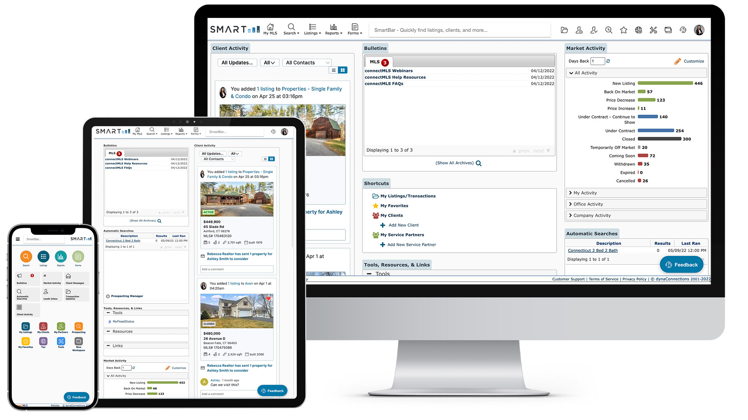
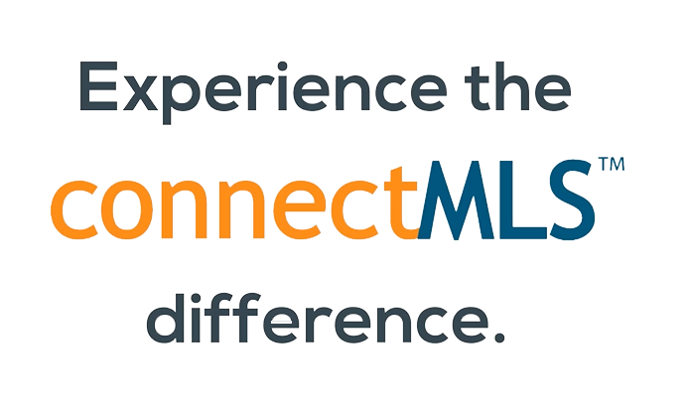
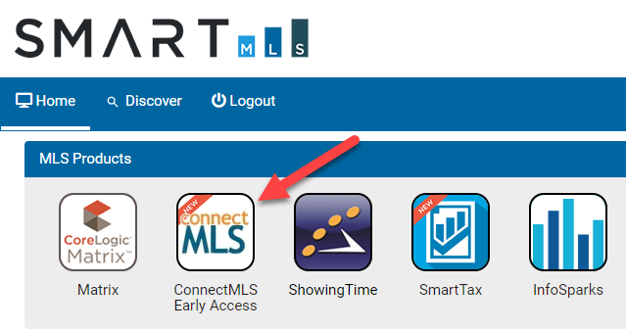
connectMLS Overview
As the industry changes, SmartMLS is committed to evolving with it and providing the foundation required to keep you at the forefront. Part of that evolution is delivering a comprehensive MLS solution that supports our entire real estate community - brokers, agents, appraisers, support staff, buyers and sellers.
That solution is connectMLS.
Built upon an innovative and highly flexible mobile-responsive design, connectMLS allows you to tailor the MLS system to support your personal workflow and efficiently service your clients. This allows the MLS to be more flexible and integrate more seamlessly with the tools real estate professionals need. We look forward to hearing feedback and productively working for you, and with you, towards a streamlined tomorrow with ConnectMLS.
3

Slide 4
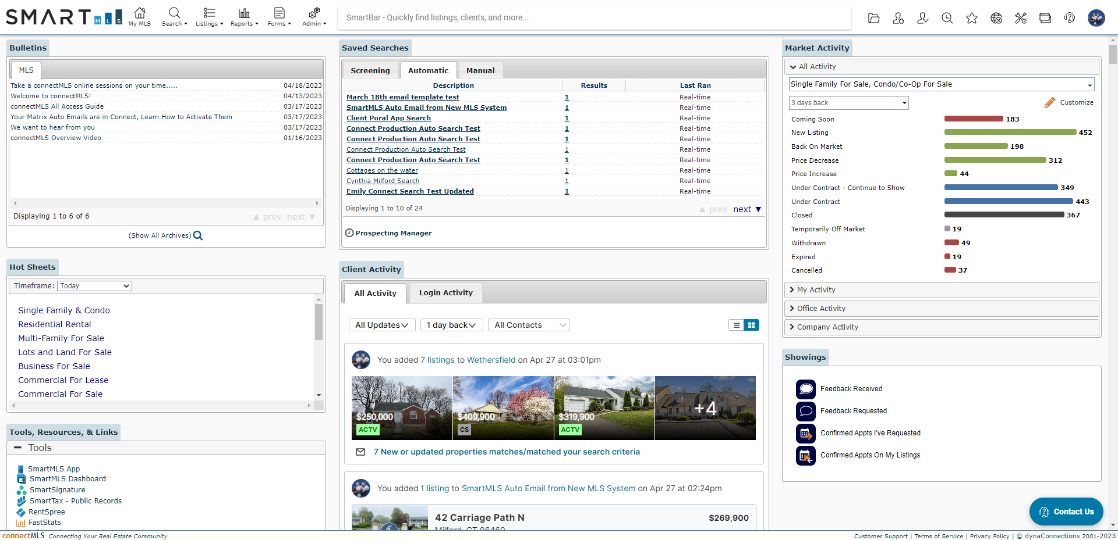
The connectMLS homepage is made up of many customizable widgets, each providing you with quick access to core MLS functionality. You can rearrange these widgets to create a layout that best supports your daily workflow.
4
Home Page Example

Slide 5
Q & A’s About connectMLS
Q - Is there an app for connectmls?
A – Yes, please visit your app store and download the app with our logo. Once you download the application, you will have the full Store. functionality of the platform on your phone. There is an app available in Apple's App Store as well as one in Google's Play.
Q - Will my Saved Clients, Saves Searches, and Auto- Emails be in connectMLS?
A - All the contacts, saved searches and auto emails that you have added to Matrix have already been copied over to connectMLS. Before using an Auto-Email that was imported from Matrix, you must activate it in connectMLS. Going forward, we recommend that you start any new auto-emails within the connectMLS system and let any old searches expire within Matrix.
Q - How can I keep track of any client interactions as a result of my auto-searches?
A - Use the Client Activity widget on your connectMLS homepage to keep tabs on how your clients are interacting with any listings you have sent them. Built-in filters allow you to focus on specific activities (such as properties a client has marked a Favorite) or even just look at one specific client’s activity. You can also choose to see all activity from all clients that has occurred over a given time period.
5

Slide 6
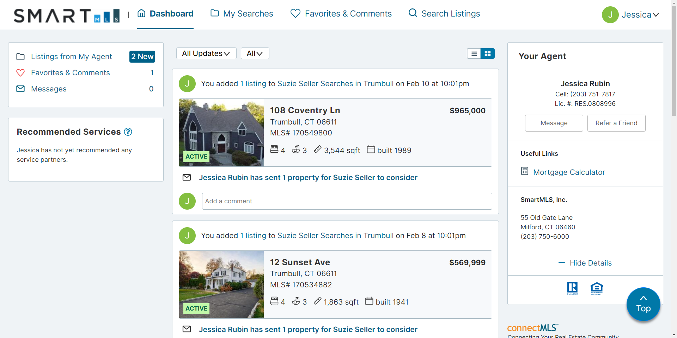
connectMLS & The Client
The Client Portal is a professionally branded, secure site that you and your client can use throughout your partnership for easy, seamless communication and collaboration. When you add a customer as a client in connectMLS, the system automatically creates them their own personal web page, called a Portal.
The Client Portal Includes the Following:
Professionally branded material readily available.
One-stop shop for all interactions - CMAs, reports, listings, documents, ect.
Client flexibility to search for anything and have direct access to disclosures.
Ability to like, favorite, dislike, and comment on properties – and the agent is instantly notified.
Full accessibility from a mobile device.
Client Portal Home Page Example
6

Slide 7
connectMLS Training & Help
Here are recorded sessions, available via Webinar in the training section on SmartMLS Homepage:
Here is a list of helpful guides containing a more in-depth look at connectMLS:
All-Access Guide to Success
ConnectMLS FAQs and Getting Started Guide
We value your input and would love to hear your feedback.
As always, we’re here to help you every step of the way.
We can’t wait for you to experience connectMLS!
Scan the QR code for additional Smartdesk information on connectMLS.
Topic | Link
Getting Started w/connectMLS | CLICK HERE
Client Engagement | CLICK HERE
Anytime, Anywhere w/connectMLS Mobile | CLICK HERE
Searching in connectMLS | CLICK HERE
7

Slide 8
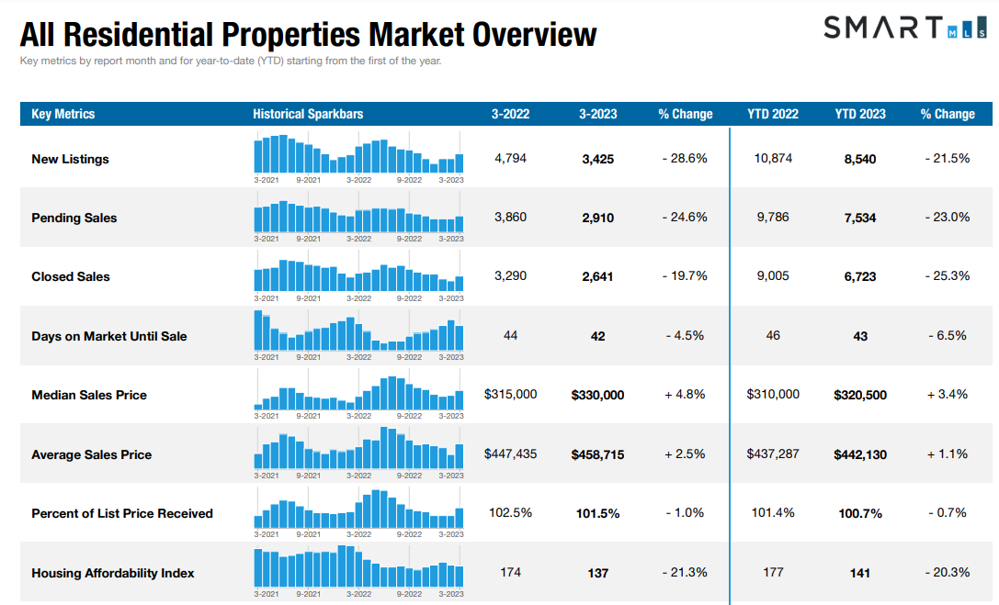
CLICK HERE the full overview of Connecticut Metrics
8
The following data is current as of April 18th, 2023. All data from SmartMLS. Report © 2023 ShowingTime

Slide 9
Single - Family Market Updates – By County
County | Number of New Listings (March 2022) | Number of New Listings (March 2023) | Percent Change | Closed Sales (March 2022) | Closed Sales (March 2023) | Percent Change | Average Sales Price (March 2022) | Average Sales Price (March 2023) | Percent Change
Fairfield | 979 | 710 | - 27.5% | 627 | 460 | - 26.6% | $923,309 | $907,094 | -1.8%
Hartford | 830 | 601 | - 27.6% | 558 | 434 | - 22.2% | $341,261 | $355,957 | + 4.3%
Lichfield | 226 | 173 | - 23.5% | 193 | 142 | - 26.4% | $463,252 | $430,055 | - 7.2%
Middlesex | 193 | 147 | - 23.8% | 129 | 111 | - 14.0% | $422,848 | $511,425 | + 20.9%
New Haven | 884 | 598 | - 32.4% | 562 | 487 | - 13.3% | $366,432 | $386,636 | + 5.5%
New London | 291 | 258 | - 11.3% | 201 | 181 | -10.0 % | $ 382,663 | $385,291 | + 0.7%
Tolland | 165 | 96 | - 41.8% | 97 | 75 | - 22.7% | $313,833 | $ 354,341 | +12.9%
Windham | 126 | 70 | - 44.4% | 100 | 84 | - 16.0% | $277,449 | $317,559 | + 14.5%
9
The following data is current as of April 18th, 2023. All data from SmartMLS. Report © 2023 ShowingTime

Slide 10
Condo/Townhouse Market Updates – By County
County | Number of New Listings (March 2022) | Number of New Listings (March 2023) | Percent Change | Closed Sales (March 2022) | Closed Sales (March 2023) | Percent Change | Average Sales Price (March 2022) | Average Sales Price (March 2023) | Percent Change
Fairfield | 373 | 297 | - 25.2% | 262 | 242 | - 7.6% | $379,347 | $444,371 | + 17.1%
Hartford | 241 | 153 | - 36.5% | 207 | 159 | - 23.2% | $205,544 | $243,714 | + 18.6%
Lichfield | 62 | 27 | - 56.5% | 30 | 16 | - 46.7% | $215,428 | $256,438 | + 19.0%
Middlesex | 67 | 32 | - 52.2% | 33 | 30 | - 9.1% | $207,575 | $230,305 | + 11.0%
New Haven | 251 | 202 | - 19.5% | 210 | 169 | - 19.5% | $211,707 | $248,359 | + 17.3%
New London | 64 | 38 | - 40.6% | 53 | 33 | - 37.7% | $234,371 | $234,264 | - 0.0%
Tolland | 32 | 21 | - 34.4 % | 20 | 13 | - 35.0% | $183,494 | $180,146 | - 1.8%
Windham | 10 | 20 | + 100.0% | 8 | 5 | - 37.5% | $228,009 | $251,280 | + 10.2%
10
The following data is current as of April 18th, 2023. All data from SmartMLS. Report © 2023 ShowingTime

Slide 11
Rental Market Updates – By County
County | Number of Active Rentals (March 2022) | Number of Active Rentals (March 2023) | Percent Change | Number of Properties Leased (March 2022) | Number of Properties Leased (March 2023) | Percent Change | Average Monthly Lease Price (March 2022) | Average Monthly Lease Price (March 2023) | Percent Change
Fairfield | 798 | 1,174 | + 47.1% | 367 | 430 | + 17.2% | $3,306 | $3,150 | - 4.7%
Hartford | 443 | 598 | + 35.0% | 151 | 202 | + 33.8% | $1,703 | $1,792 | + 5.2%
Lichfield | 256 | 302 | + 18.0% | 63 | 72 | + 14.3% | $6,457 | $3,668 | - 43.2%
Middlesex | 124 | 182 | + 46.8% | 28 | 50 | + 78.6% | $2,126 | $2,823 | + 32.8%
New Haven | 545 | 793 | + 45.5% | 214 | 259 | + 21.0% | $1,751 | $2,099 | + 19.9%
New London | 274 | 271 | - 1.1% | 67 | 98 | + 46.3% | $2,155 | $1,744 | - 19.0%
Tolland | 92 | 74 | - 19.6% | 12 | 15 | + 25.0% | $1,808 | $1,913 | + 5.8%
Windham | 60 | 50 | - 16.7% | 10 | 9 | - 10.0% | $939 | $1,550 | + 65.2%
11
The following data is current as of April 18th, 2023. All data from SmartMLS. Report © 2023 ShowingTime

Slide 12
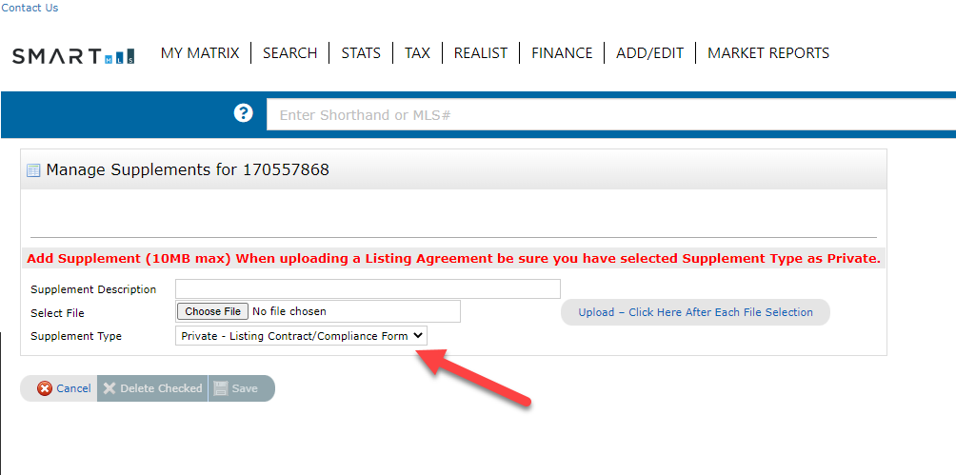
Compliance Updates – Uploading Listing Agreements
It is now required to upload a copy of either your Listing Agreement or the Listing Agreement Compliance Certification before you will be able to activate a new listing. This includes Incomplete Listings, Coming Soon Listings, and Active Listings. The required paperwork must be uploaded while the listing is in the Incomplete status.
You must also confirm that your documentation is a “Private” supplement type before completing your upload.
12

Slide 13
Need Help with Something Else?
Access our 24/7 SmartDesk HERE for answers to common questions. You can also utilize our chat feature by clicking this icon located on the bottom right corner of the SmartDesk screen.
Contact SmartMLS with assistance on Compliance, Technical Support, or Membership Questions:
203-750-6000
Support@Smartmls.com
Hours of Operation:
Monday - Thursday 8:30am-7:00pm
Friday – 8:30am – 6:00pm
Weekends – 9:00am – 3:00pm
13

