Slide 1
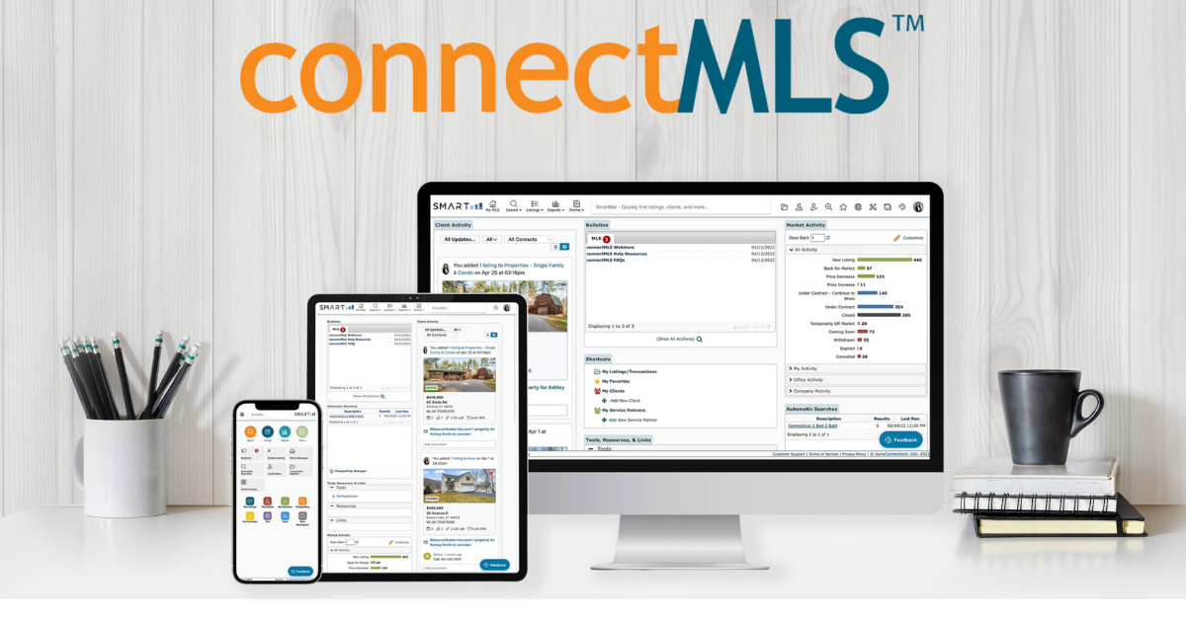
Broker Slides
Monthly Updates
JUNE 2023

Slide 2
Table of Contents
Welcome to connectMLS
connectMLS Homepage
The connectMLS Toolbar
Toolbar Shortcuts
Compare Matrix and connectMLS
What Copied Over From Matrix to connectMLS?
Branding my connectMLS
Terminology in connectMLS
connectMLS & the Client
Mobile Application
connectMLS Training & Help
3 - 16
SmartMLS Updates and Resources
SmartDesk Access
Hours of Operation

Slide 3
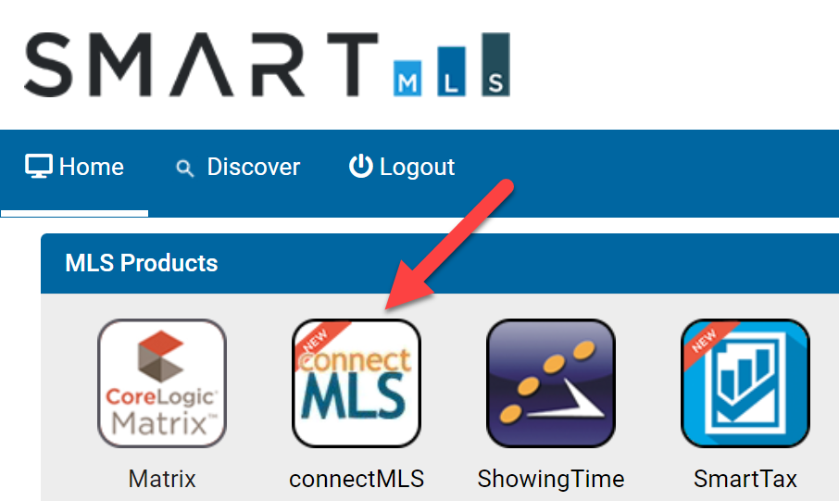
Matrix is Retiring in July
It’s time to begin the transition to connectMLS!
While Matrix will still be available through mid-July, we encourage you to take this time to transition to connectMLS. Your contacts and saved searches are waiting for you and with a few clicks, you can tailor connectMLS to support your personal workflow.
Our goal is to guide this transition with transparency and efficiency while offering training opportunities to make it as easy as possible.
To log-in, click the connectMLS tile on your dashboard. It is important to become familiar with connectMLS before Matrix is removed.
3

Slide 4
Introduction to connectMLS
4

Slide 5
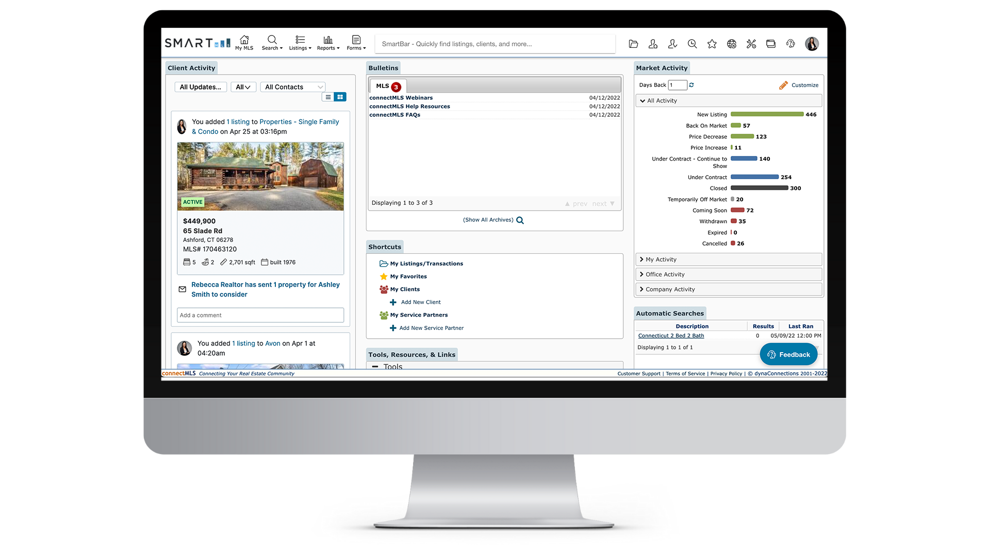
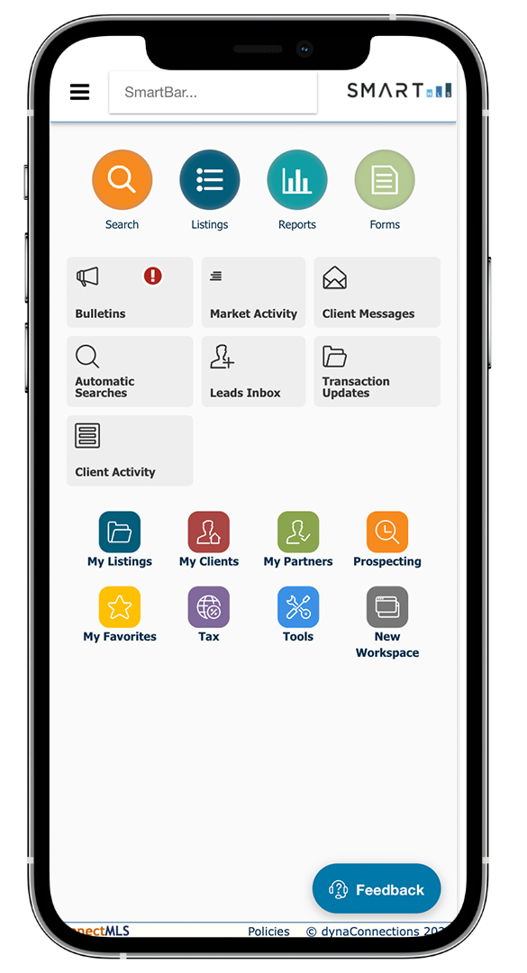
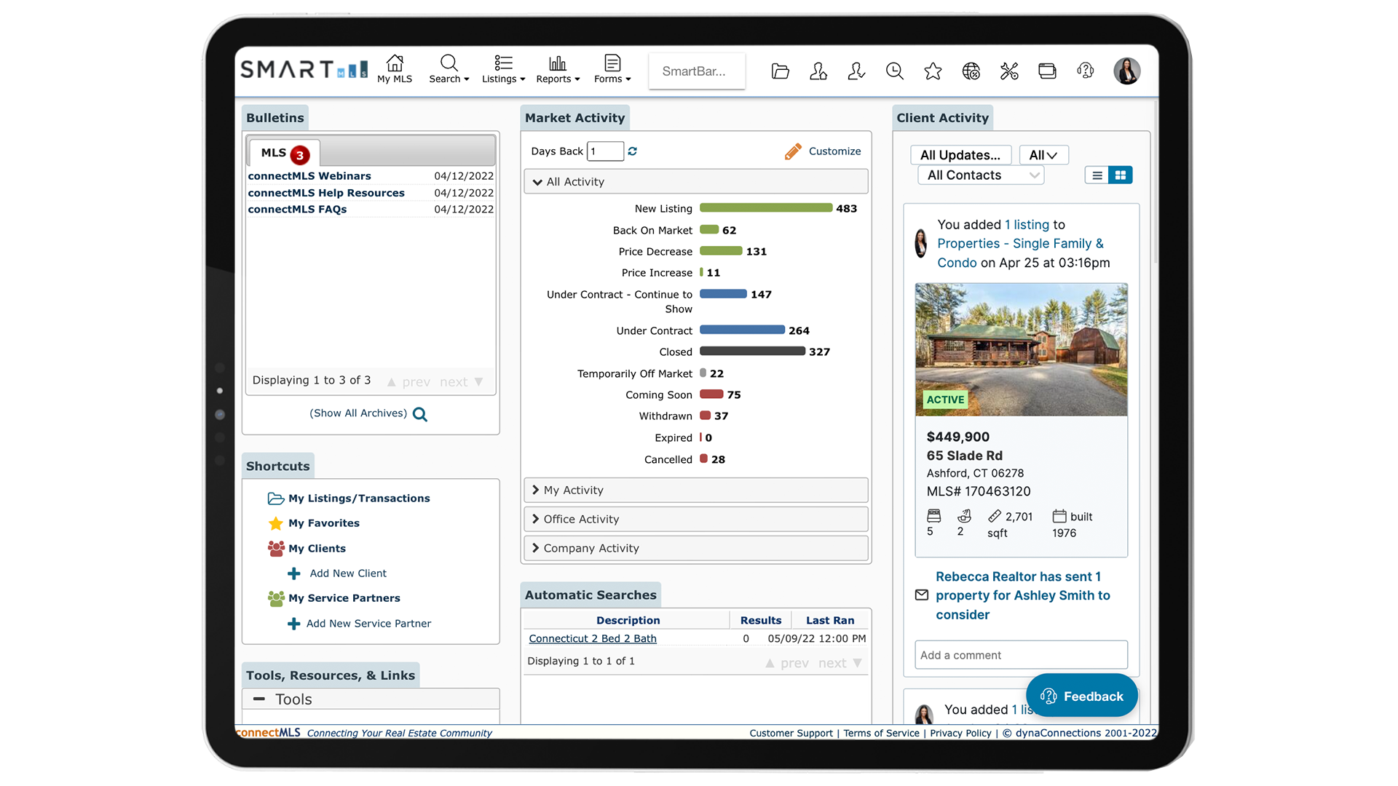
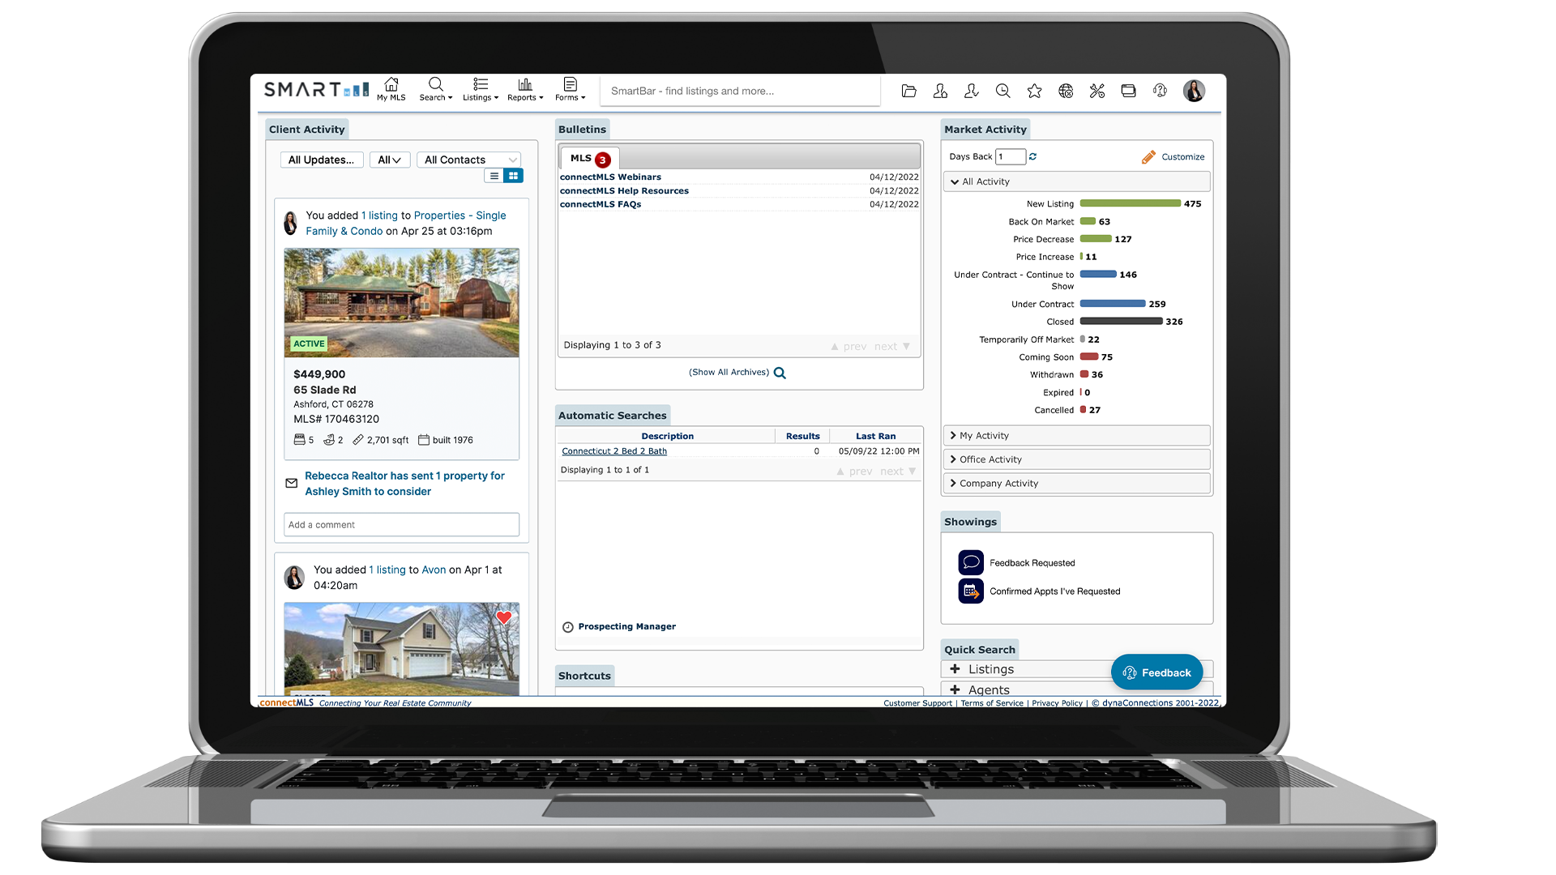
Welcome to ConnectMLS
As the industry changes, SmartMLS is committed to evolving with it and providing the foundation required to keep you at the forefront. Part of that evolution is delivering a comprehensive MLS solution that supports our entire real estate community - brokers, agents, appraisers, support staff, buyers and sellers.
That solution is connectMLS.
Built upon an innovative and highly flexible mobile-responsive design, connectMLS allows you to tailor the MLS system to support your personal workflow and efficiently service your clients. We look forward to hearing feedback and productively working for you, and with you, towards a streamlined tomorrow with ConnectMLS.
5

Slide 6
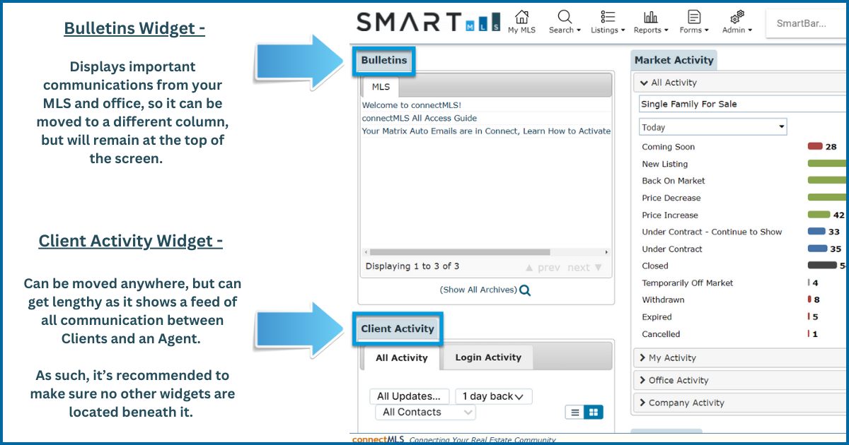
connectMLS Homepage
The connectMLS homepage is made up of many customizable widgets, each providing you with quick access to core MLS functionality. SmartMLS has pre-configured the homepage with what we feel is the best widget layout. However, you can rearrange these widgets via drag and drop to create a layout that best supports your daily workflow.
6

Slide 7
7

Slide 8
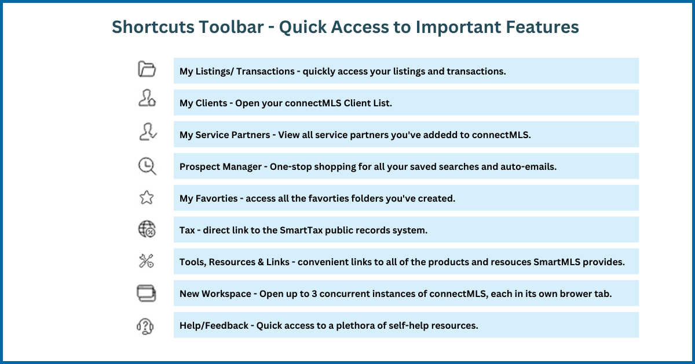
8

Slide 9
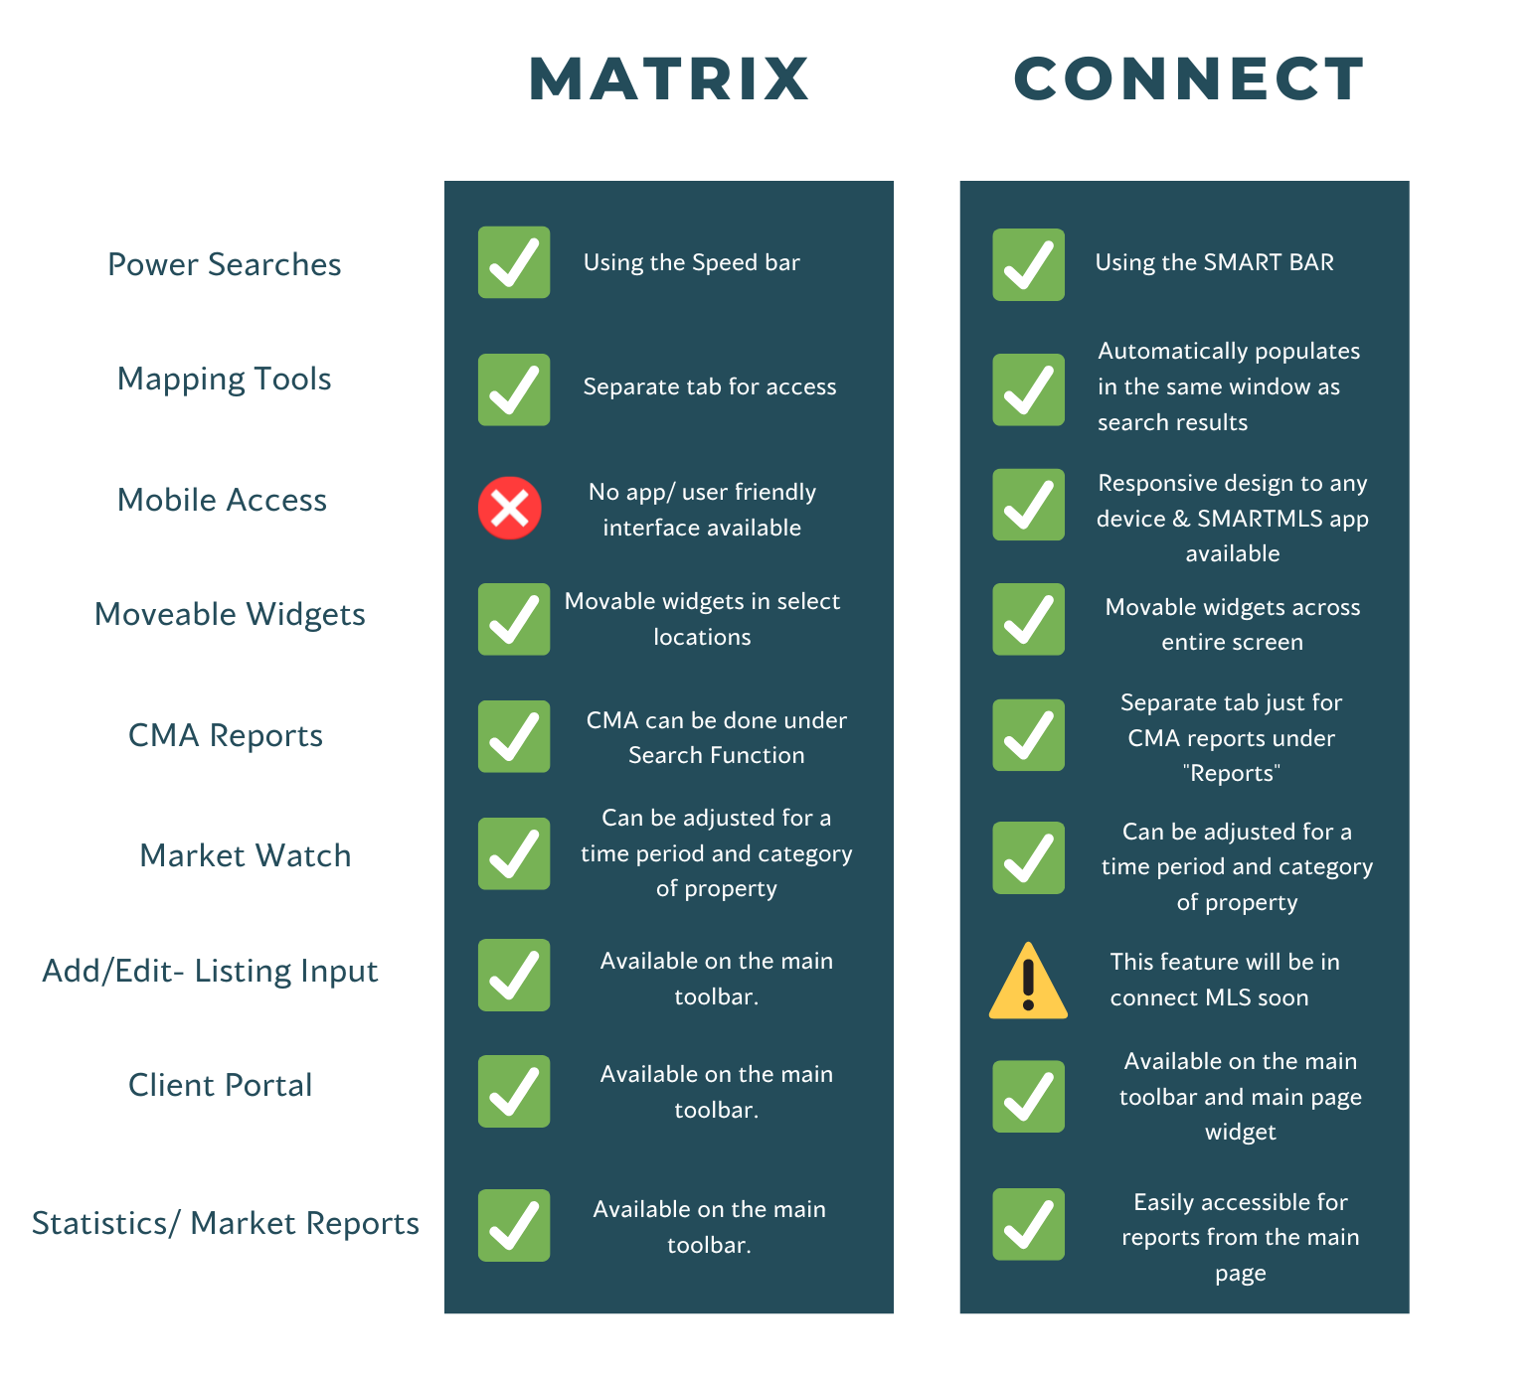
Compare Matrix and connectMLS
Wondering what features are the same, and what’s different between Matrix and connectMLS?
Here are some comparable components between Matrix and connectMLS, making your transition that much easier.
This information can also be found in the “All-Access Guide to Success” – Located HERE .
9

Slide 10
What Copied Over From Matrix?
To assist with the transition from Matrix to connectMLS, here is a helpful tool to guide your transition and understanding of items that were copied into connectMLS, and the items that you should set up in connectMLS.
What Copied over from Matrix | What Does Not Copy from Matrix
Contacts | Listing Carts
Saved Searches | CMAs
Auto-Emails | Widget Customization
Speedbar Shortcuts | Default Searches
 | Custom Displays
 | Custom Exports
Going forward, we strongly recommend adding any new contacts, saved searches, and auto-emails into connectMLS only. CLICK HERE for more information on how to transition from Matrix to connectMLS seamlessly.
10

Slide 11
Branding my connectMLS
Whenever you share something from connectMLS (ex. emailing a Client a listing) you can choose to include your professional branding. Your branding can include things like a photo, your contact information, a resume/bio, and any links to personal websites or social media sites that you would like to share. As such, this is a great place to start when setting up your account.
Making connectMLS your own is now easier than ever. In this section, we review a checklist to successfully setting up your business card and personal settings, thus optimizing how your business flows from day to day.
Manage & Modify General Information:
Set up your business card.
Upload a photo.
Establish your Display Settings.
Modify Home Page Layout.
Set up your Defaults – Email templates, Prospecting defaults, and client portal defaults.
Create & Design General Information:
Customize your widget layout on the homepage.
Add your social media links.
Add career highlights to your bio.
Team/Brokerage branding.
Fully customizable reports – CMAs, Listing Presentation materials, and statistical reports.
11

Slide 12
Terminology in connectMLS
If you have been using Matrix for any amount of time, you have most likely become accustomed to the words/names the system uses on the various menus, search screens and displays.
We have created this list to help you adjust to connectMLS system by providing the Matrix equivalent for terms you will find throughout connectMLS. This information can also be found HERE in the “All-Access Guide to Success".
MATRIX | CONNECT
Speedbar | SmartBar
News & Alerts (Widget) | Bulletins (Widget)
Market Watch (Widget) | Market Activity (Widget)
Listing Carts | My Favorites
Search Criteria | Filter
Single Line Display | List View
Contact | Client
Agent/ Client Full Display | Detail Report / Full Detail
MATRIX | CONNECT
Public Remarks Field | Overview Field
Ranking Report | Market Share Report
Combined Saved Searches / Auto Email ( Widget) | Automatic Searches (Widget)
Refine > Narrow (In search Results) | Show > Selected (In Search Results)
Refine > Discard (In Search Results) | Show > Unselected (In Search Results)
Concierge | Screener
12

Slide 13
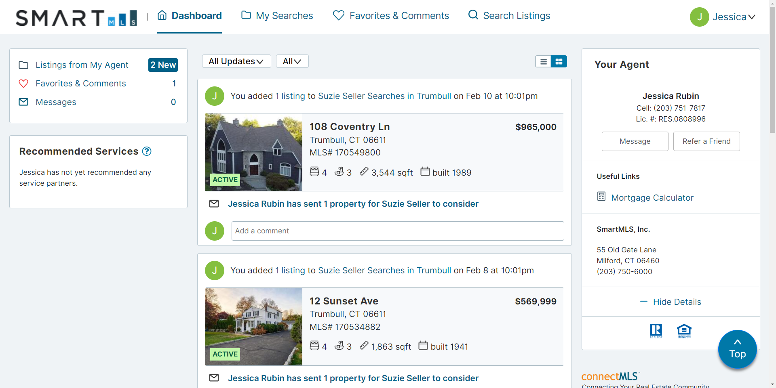
connectMLS & The Client
The Client Portal is a professionally branded, secure site that you and your client can use throughout your partnership for easy, seamless communication and collaboration. When you add a customer as a client in connectMLS, the system automatically creates them their own personal web page, called a Portal.
The Client Portal Includes the Following:
Professionally branded material readily available.
One-stop shop for all interactions - CMAs, reports, listings, documents, etc.
Client flexibility to search for anything and have direct access to disclosures.
Ability to like, favorite, dislike, and comment on properties – and the agent is instantly notified.
Full accessibility from a mobile device.
Client Portal Home Page Example
13

Slide 14
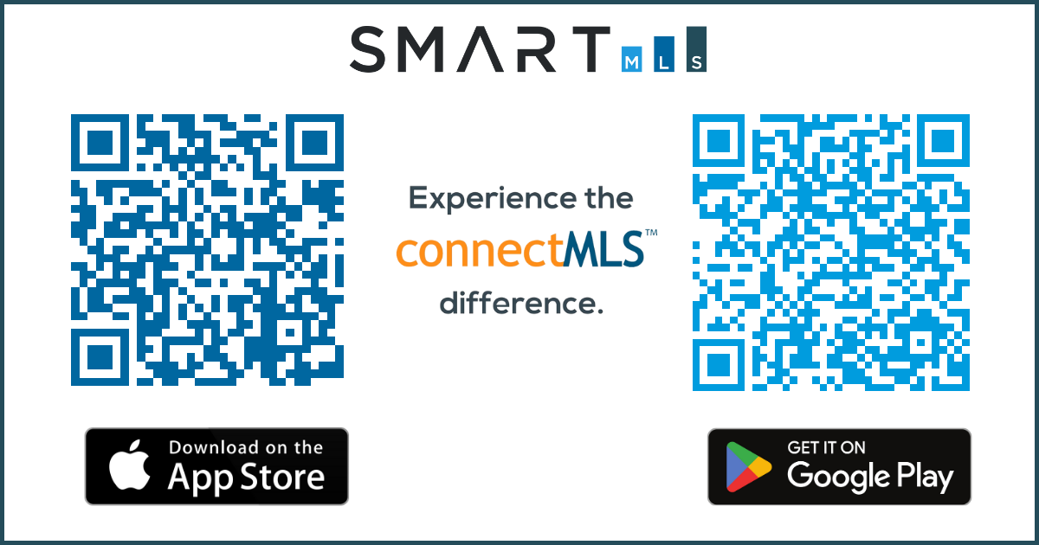
connectMLS Mobile Application
connectMLS is available on any device with internet access, including mobile and tablet devices. All features are accessible from any internet browser and will retain their full functionality.
Mobile Application Highlights Include:
When moving to a tablet setting, it will move to a two-column set-up instead of three. You are not losing any functionality.
When moving to a phone or app setting, the widgets will display as buttons that you can tap with your finger.
The mobile application can be accessible through a web browser or on the app.
The client webpage is also mobile friendly and can be accessed from any device.
Download the app by scanning the QR code
14

Slide 15
connectMLS Training & Help
Here are recorded sessions, available via Zoom in the training section on SmartMLS Homepage:
Here is a list of helpful guides containing a more in-depth look at connectMLS:
All-Access Guide to Success
ConnectMLS FAQs and Getting Started Guide
We value your input and would love to hear your feedback.
As always, we’re here to help you every step of the way.
We can’t wait for you to experience connectMLS!
Scan the QR code for additional SmartDesk information on connectMLS.
Topic | Link
Getting Started w/connectMLS | CLICK HERE
Auto-Email & Client Portal | CLICK HERE
Anytime, Anywhere w/connectLS Mobile | CLICK HERE
Searching in connectMLS | CLICK HERE
15

Slide 16
Need Help with Something Else?
Access our 24/7 SmartDesk HERE for answers to common questions. You can also utilize our chat feature by clicking this icon located on the bottom right corner of the SmartDesk screen.
Contact SmartMLS with assistance on Compliance, Technical Support, or Membership Questions:
203-750-6000
Support@Smartmls.com
Hours of Operation:
Monday - Thursday 8:30am-7:00pm
Friday – 8:30am – 6:00pm
Weekends – 9:00am – 3:00pm
16

