Slide 1
Broker Slides
Monthly Updates
AUGUST 2023

Slide 2
Table of Contents
News and Alerts – connectMLS & SmartTax
connectMLS Updates
connectMLS Product Development
SmartTax
3 - 5
Market Statistics – June 2023
Residential Overview
Local Market Updates – By County
Single – Family
Townhouse/ Condos
Rental Report – By County
6 - 9
10-11
Compliance
Fraud Alerts
2023 - 2024 Tax Updates
SmartMLS Updates and Resources
SmartDesk Access
Hours of Operation
12

Slide 3
connectMLS- Transition Extension
We have been presented with an opportunity to extend the transition timeline from Matrix to connectMLS. We will provide 30 days notice before the switchover.
Extending the cutover gives all users an opportunity to become better acclimated to the features and enhancements that are continuously being added as a result of your insightful feedback.
We are currently developing additional learning opportunities and resources to reflect new updates to connectMLS. It has been enlightening to learn about the different ways users make the most of the MLS to suit their unique workflows and meet the needs of clients. By agreeing to push the cutover date back, we can deliver a more robust system for you and your clients.
We appreciate your feedback and encourage you to continue sharing it with us. We will continue to be with you every step of the way.
3

Slide 4
connectMLS- Product Developments
Here are some of the latest product updates:
Search by Proximity/ Radius Search in connectMLS – Search for a listing within a radius of an address, directly from the search screen. CLICK HERE for more information on how to search by proximity.
Additional Print Options - available in the drop-down menu when viewing a full view of a property. An example of additional print options include Listing History, Property History, and the Tax Report.
Additional Field Choices - have been added to the Add/Remove field list on the search screen.
Multiple Address Search - has been added to the Search menu - check it out!
4

Slide 5
SmartTax Replacing Realist
SmartMLS is dedicated to providing the tools necessary to help you work more efficiently. In preparation for upgrades to come, we are retiring Realist and introducing SmartTax - our new public records program.
Prospecting – Easy to find leads based on public records and sales/transfer history. How to Prospect in SmartTax
CMA – The CMA & Client report is available from both the SmartTax property report and the connectMLS full detail report. SmartTax CMA
Extensive Property Data – The property report is the most comprehensive report in SmartTax and provides access to all the public records information the SmartMLS has on file. SmartTax Property Report
CLICK HERE to access our SmartTax Overview Webinar!
5

Slide 6
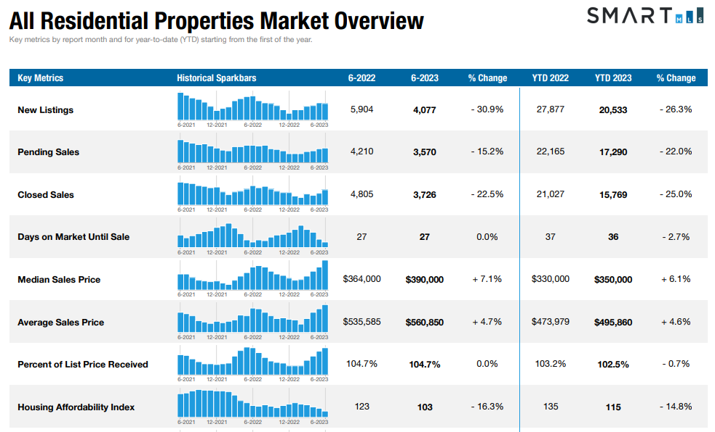
CLICK HERE to view the full overview of Connecticut Metrics
6
The following data is current as of July 8th, 2023. All data from SmartMLS. Report © 2023 ShowingTime

Slide 7
Single - Family Market Updates – By County
County | Number of New Listings (June 2022) | Number of New Listings (June 2023) | Percent Change | Closed Sales (June 2022) | Closed Sales (June 2023) | Percent Change | Average Sales Price (June 2022) | Average Sales Price (June 2023) | Percent Change
Fairfield | 1,243 | 761 | - 38.8% | 953 | 757 | - 20.6% | $1,147,559 | $1,138,741 | - 0.8%
Hartford | 1,075 | 793 | - 26.2% | 943 | 698 | - 26.0% | $396,343 | $419,800 | + 5.9%
Lichfield | 343 | 235 | - 31.5% | 229 | 185 | - 19.2% | $491,837 | $585,309 | + 19.0%
Middlesex | 296 | 180 | - 39.2% | 193 | 143 | - 25.9% | $468,994 | $501,934 | + 7.0%
New Haven | 1,019 | 725 | - 28.9% | 813 | 621 | - 23.6% | $419,401 | $450,339 | + 7.4%
New London | 389 | 262 | - 32.6% | 325 | 260 | -20.0 % | $423,232 | $423,306 | + 0.0%
Tolland | 258 | 147 | - 43.0% | 174 | 130 | - 25.3% | $365,895 | $395,651 | + 8.1%
Windham | 163 | 111 | - 31.9% | 151 | 107 | - 29.1% | $323,879 | $367,718 | + 13.5%
7
The following data is current as of June 8th, 2023. All data from SmartMLS. Report © 2023 ShowingTime

Slide 8
Condo/Townhouse Market Updates – By County
County | Number of New Listings (June 2022) | Number of New Listings (June 2023) | Percent Change | Closed Sales (June 2022) | Closed Sales (June 2023) | Percent Change | Average Sales Price (June 2022) | Average Sales Price (June 2023) | Percent Change
Fairfield | 398 | 267 | - 32.9% | 322 | 264 | - 18.0% | $440,498 | $456,389 | + 3.6%
Hartford | 240 | 202 | - 15.8% | 236 | 197 | - 16.5% | $239,982 | $269,850 | + 12.4%
Lichfield | 41 | 42 | + 2.4% | 39 | 39 | 0 .0% | $195,558 | $261,072 | + 33.5%
Middlesex | 49 | 45 | - 8.2% | 48 | 45 | - 6.3% | $256,160 | $228,590 | - 10.8%
New Haven | 280 | 242 | - 13.6% | 283 | 210 | - 25.8% | $250,542 | $288,490 | + 15.1%
New London | 75 | 35 | - 53.3% | 53 | 38 | - 28.3% | $229,568 | $311,615 | + 35.7%
Tolland | 31 | 20 | - 35.5% | 29 | 21 | - 27.6% | $214,600 | $228,574 | + 6.5%
Windham | 4 | 10 | 150.0% | 14 | 11 | - 21.4% | $290,195 | $242,582 | - 16.4%
8
The following data is current as of June 8th, 2023. All data from SmartMLS. Report © 2023 ShowingTime

Slide 9
Rental Market Updates – By County
County | Number of Active Rentals (June 2022) | Number of Active Rentals (June 2023) | Percent Change | Number of Properties Leased (June 2022) | Number of Properties Leased (June 2023) | Percent Change | Average Monthly Lease Price (June 2022) | Average Monthly Lease Price (June 2023) | Percent Change
Fairfield | 969 | 1,156 | + 19.3% | 400 | 533 | + 33.3% | $5,174 | $4,662 | - 9.9%
Hartford | 455 | 609 | + 33.8% | 166 | 260 | + 56.6% | $2,175 | $1,983 | - 8.8%
Lichfield | 231 | 300 | + 29.9% | 81 | 57 | - 29.6% | $6,050 | $4,420 | - 26.9%
Middlesex | 140 | 190 | + 35.7% | 40 | 58 | + 45.0% | $2,165 | $2,429 | + 12.2%
New Haven | 604 | 877 | + 45.2% | 262 | 341 | + 30.2% | $1,973 | $2,338 | + 18.5%
New London | 274 | 313 | +14.2% | 66 | 78 | + 18.2% | $2,179 | $2,502 | + 14.8%
Tolland | 77 | 83 | + 7.8% | 18 | 27 | + 50.0% | $1,879 | $1,758 | - 6.4%
Windham | 52 | 53 | + 1.9% | 11 | 7 | - 36.4% | $1,130 | $2,021 | + 78.9%
9
The following data is current as of June 8th, 2023. All data from SmartMLS. Report © 2023 ShowingTime

Slide 10
Compliance Updates – Scam Alert
There has been a recent rise in fraudulent activity related to vacant land transactions across the country, and close to home here in Connecticut. Fraudsters have been conducting detailed research on these parcels and are well-versed in the real estate process.
To help identify fraudulent transactions, real estate professionals should be on high alert for specific “potential red flags” such as:
Sellers located in another state or country and claiming to be the owner(s) of the land.
Undervalued prices.
An unreasonable rush to close and failure to provide valid identification, such as a current driver’s license.
10

Slide 11
2023 – 2024 Tax Updates
SmartMLS has completed the 2023-2024 tax updates for 150 towns in CT.
SmartMLS will update the tax information on Active, UC-Continue to Show, Under Contract, Temp and Withdrawn listings as we receive the updated information from the Assessor’s offices. Click here to see the full list.
A listing will need to be updated manually if the property is new construction or one of the rare instances where we do not have a tax record for the parcel.
You can update your listing using the My Listings Widget on the Matrix Dashboard. Simply select “My Listings Needing Tax Updates.” Please refer to the additional instructions found here: Updating the tax data on your own listings
If tax record data is incorrect or needs to be updated, please use the tax discrepancy link at either the top or the bottom of the Full Tax display to report the error. See the article linked here for full instructions.
Email tax@smartmls.com if you have any questions or issues.
11

Slide 12
Need Help with Something Else?
Access our 24/7 SmartDesk HERE for answers to common questions. You can also utilize our chat feature by clicking this icon located on the bottom right corner of the SmartDesk screen.
Contact SmartMLS with assistance on Compliance, Technical Support, or Membership Questions:
203-750-6000
Support@Smartmls.com
Hours of Operation:
Monday - Thursday 8:30am-7:00pm
Friday – 8:30am – 6:00pm
Weekends – 9:00am – 3:00pm
12

