Slide 1
Broker Slides
Monthly Updates
September 2023

Slide 2
Table of Contents
News and Alerts – connectMLS Updates
3-7
Market Statistics - August 2023
Exclusive Summary of Market Statistics
Rental Report – By County
Local market Updates – By County
Single – Family
Townhouse/ Condos
8-11
Compliance
Tax Update
12
SmartMLS Updates and Resources
SmartDesk Access
Hours of Operation
13

Slide 3
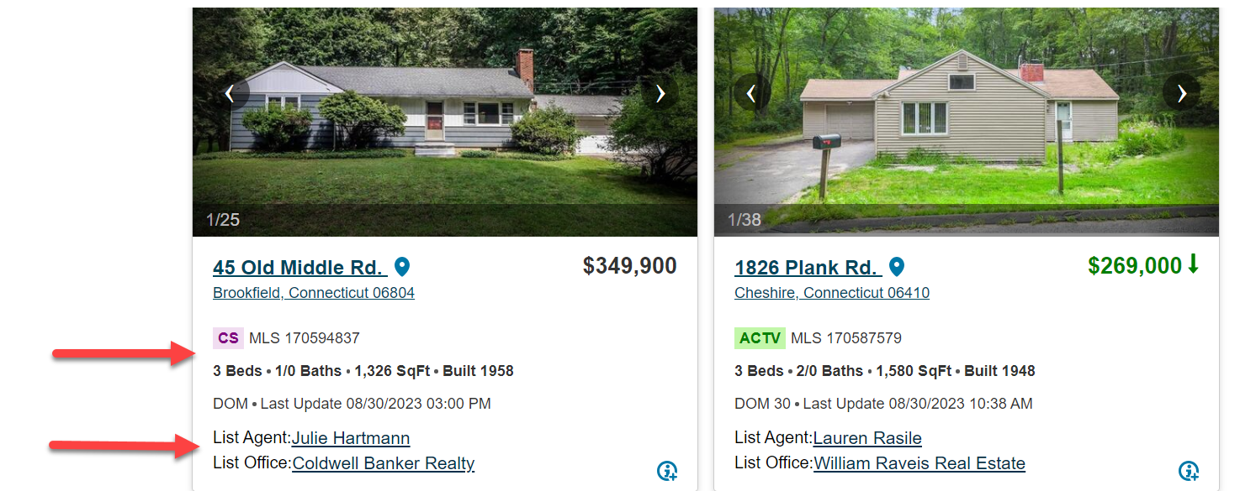
News and Alerts – connectMLS Updates
Gallery View in Search Results –We have updated the picture viewer to show listing agent information, last updated date, and a picture caption!
3

Slide 4
News and Alerts – connectMLS Updates
Proximity search is now an automatic default on your search screen.
4

Slide 5
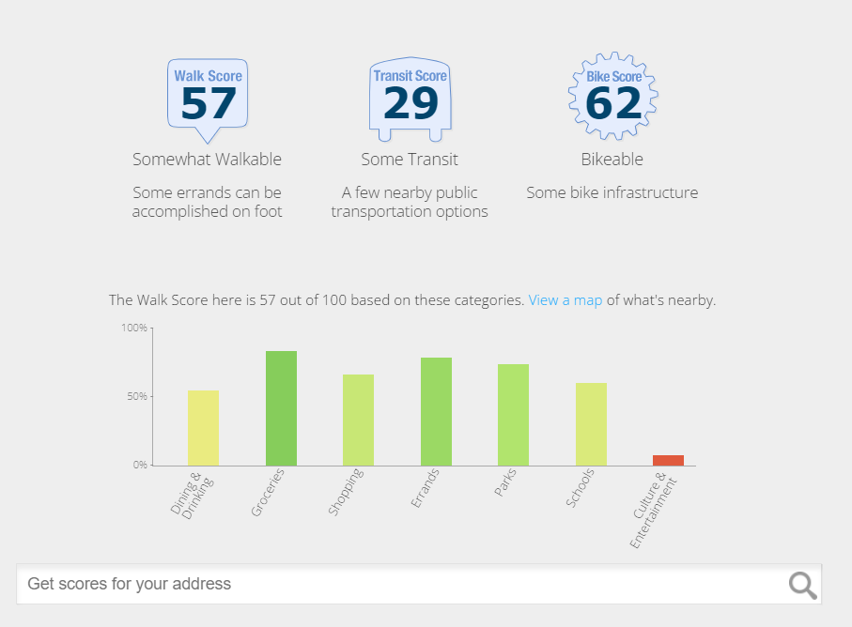
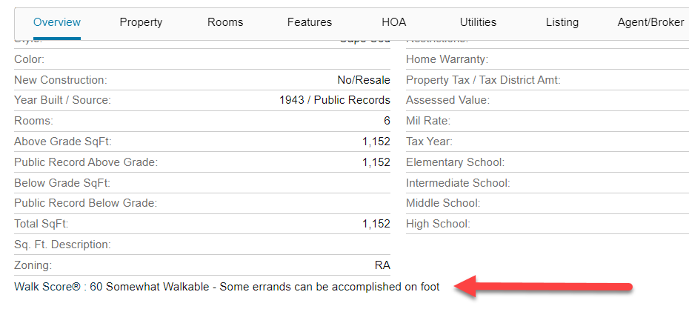
News and Alerts – connectMLS Updates
Walkscore – This unique addition allows you to find information about car dependency, transit opportunities, and bike scores in a given location.
5

Slide 6
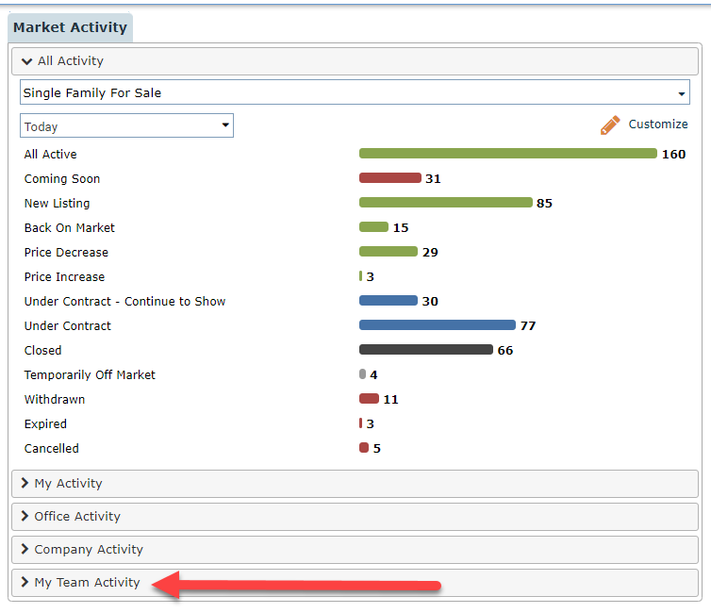
News and Alerts – connectMLS Updates
Under the Market Activity Widget, we have added a designated section for “My Team Activity”, which shows all activity for on-market listings and off-market listings.
6

Slide 7
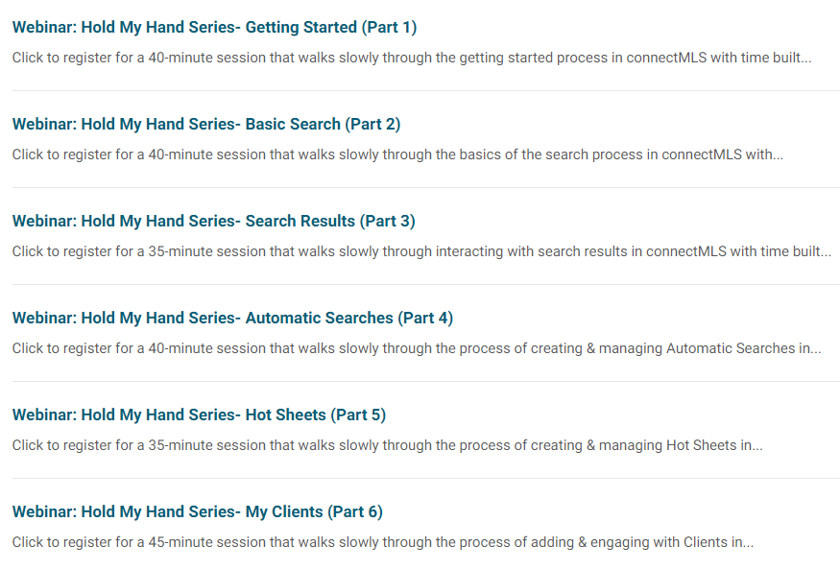
News and Alerts – connectMLS Trainings
SmartMLS is committed to providing you with the tools and resources necessary to succeed in connectMLS. We are now integrating NEW classes are in our events page.
Hold My Hand Series
These sessions are designed to be taken in order as a series & provide a slow & steady approach to learning connectMLS!
Each session is 30-45 minutes & includes dedicated time for you to follow along & try firsthand everything that's discussed in the training. All sessions are available on-demand or can be scheduled in advance.
CLICK HERE to access the Hold My Hand Series – Available Now!
7

Slide 8
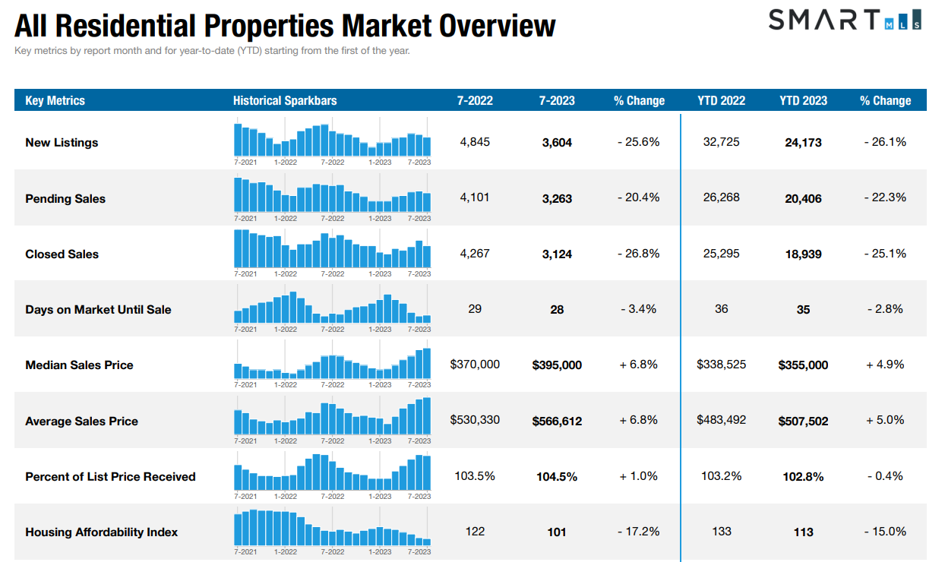
CLICK HERE to get the full overview of Connecticut Metrics
8
The following data is current as of August 8th, 2023. All data from SmartMLS. Report © 2023 ShowingTime

Slide 9
Single - Family Market Updates – By County
County | Number of New Listings (July 2022) | Number of New Listings (July 2023) | Percent Change | Closed Sales (July 2022) | Closed Sales (July 2023) | Percent Change | Average Sales Price (July 2022) | Average Sales Price (July 2023) | Percent Change
Fairfield | 950 | 682 | - 28.2% | 905 | 652 | - 28.0% | $1,054,492 | $1,135,955 | + 7.7%
Hartford | 906 | 703 | - 22.4% | 773 | 601 | - 22.3% | $397,909 | $424,468 | + 6.7%
Lichfield | 286 | 202 | - 29.4% | 224 | 154 | - 31.3% | $506,457 | $546,933 | + 8.0%
Middlesex | 218 | 161 | - 26.1% | 192 | 161 | - 16.1% | $472,973 | $535,370 | + 13.2%
New Haven | 849 | 616 | - 27.4% | 713 | 522 | - 26.8% | $426,585 | $452,390 | + 6.0%
New London | 365 | 257 | + 29.6% | 269 | 214 | - 20.4% | $ 336,450 | $352,471 | + 4.8%
Tolland | 158 | 129 | - 18.4% | 174 | 121 | - 30.5% | $363,777 | $ 376,407 | + 3.5%
Windham | 157 | 92 | - 41.4% | 105 | 77 | - 26.7% | $329,114 | $371,431 | + 12.9%
9
The following data is current as of August 8th, 2023. All data from SmartMLS. Report © 2023 ShowingTime

Slide 10
Condo/Townhouse Market Updates – By County
County | Number of New Listings (July 2022) | Number of New Listings (July 2023) | Percent Change | Closed Sales (July 2022) | Closed Sales (July 2023) | Percent Change | Average Sales Price (July 2022) | Average Sales Price (July 2023) | Percent Change
Fairfield | 329 | 213 | - 35.3% | 293 | 208 | - 29.0% | $454,965 | $463,593 | + 1.9%
Hartford | 234 | 204 | - 12.8% | 211 | 153 | - 27.5% | $235,587 | $266,534 | + 13.1%
Lichfield | 56 | 38 | - 32.1% | 34 | 27 | - 20.6% | $239,537 | $222,126 | - 7.3%
Middlesex | 41 | 44 | + 7.3% | 41 | 27 | - 34.1 % | $239,360 | $275,370 | + 15.0%
New Haven | 210 | 196 | - 6.7% | 240 | 157 | - 34.6% | $246,539 | $274,501 | + 11.3%
New London | 54 | 37 | - 31.5% | 56 | 33 | - 41.1% | $228,710 | $276,015 | +20.7%
Tolland | 21 | 23 | + 9.5 % | 29 | 12 | - 58.6% | $200,972 | $238,308 | + 18.6%
Windham | 11 | 7 | - 36.4% | 8 | 5 | - 37.5% | $200,375 | $310,800 | + 55.1%
10
The following data is current as of August 8th, 2023. All data from SmartMLS. Report © 2023 ShowingTime

Slide 11
Rental Market Updates – By County
County | Number of Active Rentals (July 2022) | Number of Active Rentals (July 2023) | Percent Change | Number of Properties Leased (July 2022) | Number of Properties Leased (July 2023) | Percent Change | Average Monthly Lease Price (July 2022) | Average Monthly Lease Price (July 2023) | Percent Change
Fairfield | 973 | 1,133 | + 16.4% | 422 | 489 | + 15.9% | $5,185 | $4,306 | - 17.0%
Hartford | 536 | 587 | + 9.5% | 176 | 255 | + 44.9% | $1,833 | $1,904 | + 3.9%
Lichfield | 245 | 277 | + 13.1% | 55 | 83 | + 50.9% | $5,069 | $4,761 | - 6.1%
Middlesex | 151 | 194 | + 28.5% | 45 | 43 | - 4.4% | $2,367 | $3,004 | + 26.9%
New Haven | 633 | 843 | + 33.2% | 260 | 330 | + 26.9% | $2,093 | $2,173 | + 3.8%
New London | 294 | 311 | + 5.8% | 68 | 82 | + 20.6% | $2,247 | $1,925 | -14.3%
Tolland | 86 | 80 | - 7.0% | 16 | 14 | - 12.5% | $1,560 | $2,087 | + 33.7%
Windham | 53 | 49 | - 7.5% | 12 | 9 | - 25.0% | $1,515 | $1,342 | + 20.4%
11
The following data is current as of August 8th, 2023. All data from SmartMLS. Report © 2023 ShowingTime

Slide 12
Compliance Updates – Final Tax Updates
SmartMLS has completed the 2023-2024 tax updates for all 169 towns in CT. Click here to see the full list.
If you have listings in any of these towns, the tax information (tax amount, mil rate and tax year) was automatically updated in Connect and Matrix, unless the property is new construction or one of the rare instances where we do not have a tax record for the parcel. In these situations, the listing will need to be updated manually.
If tax record data is incorrect or needs to be updated, please use the tax discrepancy link at either the top or the bottom of the Full Tax display to report the error. See the article linked here for full instructions.
You can update your listing using the My Listings Widget on the Matrix Dashboard. Simply select “My Listings Need Tax Updates”.
Please refer to the additional instructions found here: Updating the tax data on your own listings
Email tax@smartmls.com if you have any questions or issues.
12

Slide 13
Need Help with Something Else?
Access our 24/7 SmartDesk HERE for answers to common questions. You can also utilize our chat feature by clicking this icon located on the bottom right corner of the SmartDesk screen.
Contact SmartMLS with assistance on Compliance, Technical Support, or Membership Questions:
203-750-6000
Support@Smartmls.com
Hours of Operation:
Monday- Thursday 8:30am-7:00pm
Friday – 8:30am – 6:00pm
Weekends – 9am – 3:00pm
13

