Slide 1
Broker Slides
Monthly Updates
November 2023

Slide 2
Table of Contents
News and Alerts – connectMLS Updates
3-5
Market Statistics – September 2023
Exclusive Summary of Market Statistics
Rental Report – By County
Local market Updates – By County
Single – Family
Townhouse/ Condos
6-9
Compliance
Tax Update
10
SmartMLS Updates and Resources
SmartDesk Access
Hours of Operation
11

Slide 3
Over the next couple of months, we will add a tip of the week under the News/Alerts in Matrix and connectMLS. Each “dot” will come together to draw a clear picture of understanding in connectMLS.
Looking to locate the previous connect the dots posts? This article includes all the entries in our Connect the Dots series.
CLICK HERE to access the list.
3

Slide 4
connectMLS Training Course Menu
Here is a current list of our “Watch Now” Webinar classes.
Getting Started in connectMLS –
Ready to get started in connectMLS? This training session will cover everything you need to understand and use the system. Setup your business card, access the system on any device, engage with your clients and become familiar with the tools you need to get you started.
Basic Search –
This training will show you how to run a property search in connectMLS and view/share the results.
Auto-Email & The Client Portal –
This session will show you how to set up new auto emails and manage your clients by using the Saved Search Widget, Client Activity Widget and Screener functionality. The basics of the Client Portal will also be covered so you can start sharing listings with your clients.
Adding & Managing Listings –
This session will show you how locate your listings in connectMLS and how to add a new listing. You will also learn how to edit listing details and how to add photos and documents to a listing.
Getting to Know SmartTax –
This training provides an overview of our new public records program, SmartTax. SmartTax includes tools like prospecting, interactive maps and extensive property data.
CLICK HERE to access our library of Watch Now Webinars!
4

Slide 5
These sessions are designed to be taken in order as a series & provide a slow & steady approach to learning connectMLS! Each session is 30-45 minutes & includes dedicated time for you to follow along & try firsthand everything that's discussed in the training. All sessions are available on-demand or can be scheduled in advance. Click to see all available sessions
5

Slide 6
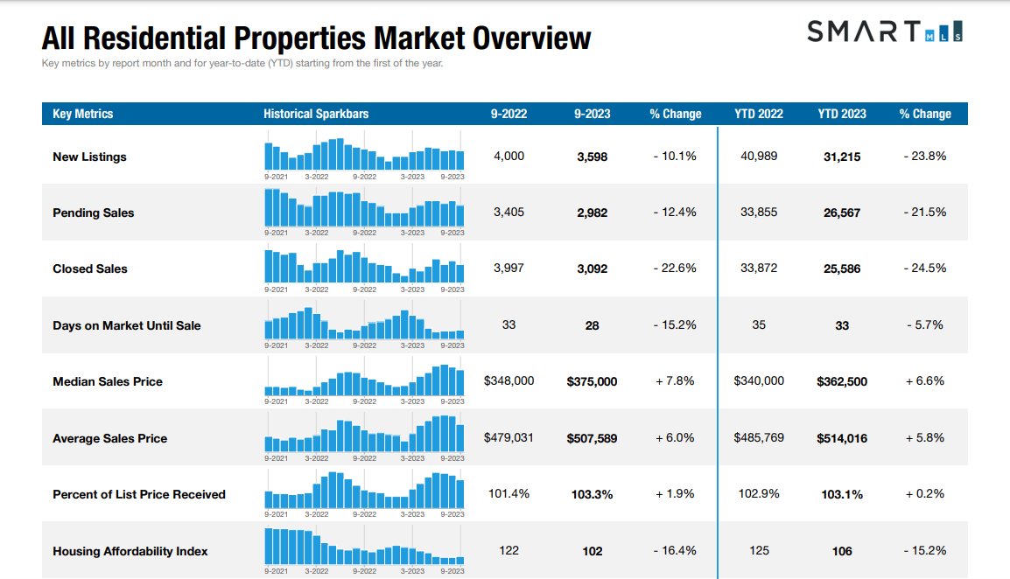
CLICK HERE to get the full overview of Connecticut Metrics
6
The following data is current as of October 8th, 2023. All data from SmartMLS. Report © 2023 ShowingTime

Slide 7
Single - Family Market Updates – By County
County | Number of New Listings (Sep. 2022) | Number of New Listings (Sep. 2023) | Percent Change | Closed Sales (Sep. 2022) | Closed Sales (Sep. 2023) | Percent Change | Average Sales Price (Sep. 2022) | Average Sales Price (Sep. 2023) | Percent Change
Fairfield | 797 | 708 | - 11.2% | 757 | 548 | - 27.6% | $931,204 | $948,156 | + 1.8%
Hartford | 685 | 635 | - 7.3% | 762 | 600 | - 21.3% | $320,000 | $365,000 | + 14.1%
Lichfield | 228 | 228 | 0.0 % | 238 | 174 | - 26.9% | $453,010 | $564,778 | + 24.7%
Middlesex | 184 | 175 | - 4.9% | 164 | 118 | - 28.0% | $451,090 | $512,221 | + 13.6%
New Haven | 717 | 646 | - 9.9% | 668 | 520 | - 22.2% | $414,400 | $446,092 | + 7.6%
New London | 298 | 214 | - 28.2% | 274 | 230 | - 16.1% | $ 406,906 | $507,930 | + 24.8%
Tolland | 140 | 119 | - 15.0% | 163 | 96 | - 41.1% | $354,927 | $ 406,227 | + 14.5%
Windham | 103 | 111 | + 7.8% | 102 | 89 | - 12.7% | $320,676 | $338,918 | + 5.7%
7
The following data is current as of October 8th, 2023. All data from SmartMLS. Report © 2023 ShowingTime

Slide 8
Condo/Townhouse Market Updates – By County
County | Number of New Listings (Sep. 2022) | Number of New Listings (Sep. 2023) | Percent Change | Closed Sales (Sep. 2022) | Closed Sales (Sep. 2023) | Percent Change | Average Sales Price (Sep. 2022) | Average Sales Price (Sep. 2023) | Percent Change
Fairfield | 302 | 242 | - 19.9% | 273 | 208 | - 23.8% | $457,546 | $470,918 | + 2.9%
Hartford | 181 | 178 | - 1.7% | 242 | 203 | - 16.1% | $235,723 | $248,374 | + 5.4%
Lichfield | 33 | 37 | + 12.1% | 39 | 34 | - 12.8% | $206,596 | $223,551 | + 8.2%
Middlesex | 33 | 42 | + 27.3% | 36 | 40 | + 11.1 % | $204,562 | $269,350 | + 31.7%
New Haven | 219 | 181 | - 17.4% | 207 | 171 | - 17.4% | $238,679 | $262,921 | + 10.2%
New London | 55 | 54 | - 1.8% | 43 | 34 | - 20.9% | $259,871 | $271,229 | +4.4%
Tolland | 16 | 20 | + 25.0 % | 20 | 20 | 0.0 % | $212,795 | $224,145 | + 5.3%
Windham | 9 | 8 | - 11.1% | 9 | 7 | - 22.2% | $209,433 | $221,368 | + 5.7%
8
The following data is current as of October 8th, 2023. All data from SmartMLS. Report © 2023 ShowingTime

Slide 9
Rental Market Updates – By County
County | Number of Active Rentals ( Sep. 2022) | Number of Active Rentals (Sep. 2023) | Percent Change | Number of Properties Leased (Sep. 2022) | Number of Properties Leased (Sep. 2023) | Percent Change | Average Monthly Lease Price (Sep. 2022) | Average Monthly Lease Price (Sep. 2023) | Percent Change
Fairfield | 1015 | 1,037 | + 2.2% | 431 | 473 | + 9.7% | $3,813 | $3,619 | - 5.1%
Hartford | 524 | 633 | + 20.8% | 168 | 206 | + 22.6% | $1,807 | $1,870 | + 3.5%
Lichfield | 249 | 260 | + 4.4% | 81 | 76 | - 6.2% | $2,844 | $2,213 | - 22.2%
Middlesex | 177 | 208 | + 17.5% | 58 | 57 | - 1.7% | $2,241 | $1,969 | - 12.1%
New Haven | 682 | 808 | + 18.5% | 256 | 277 | + 8.2% | $2,095 | $2,094 | 0.0%
New London | 301 | 321 | + 6.6% | 94 | 71 | - 24.5% | $1,981 | $2,267 | + 14.5%
Tolland | 98 | 70 | - 28.6% | 10 | 23 | + 130.0% | $1,520 | $2,198 | + 44.6%
Windham | 44 | 52 | + 18.2% | 9 | 6 | - 33.3% | $1,688 | $1,633 | - 3.2%
9
The following data is current as of October 8th, 2023. All data from SmartMLS. Report © 2023 ShowingTime

Slide 10
Compliance Updates – Non-MLS Advertising
As a member of the MLS, agents agree to comply with the MLS Rules & Regulations including filing all mandatory listings with the service. This is to ensure clear cooperation between agents and brokers which is an essential part of the MLS and making the market work.
Non-MLS advertising is a violation of the MLS’s clear cooperation policy. Bringing attention to a property prior to having a listing in the MLS is considered Non-MLS advertising.
Advertising Includes:
Prematurely placing a sign on the property.
Emails to the public.
Emails to other brokerages.
Social media posts.
Scan the QR code for more information on what is considered public marketing.
10

Slide 11
Need Help with Something Else?
Access our 24/7 SmartDesk HERE for answers to common questions. You can also utilize our chat feature by clicking this icon located on the bottom right corner of the SmartDesk screen.
Contact SmartMLS with assistance on Compliance, Technical Support, or Membership Questions:
203-750-6000
Support@Smartmls.com
Hours of Operation:
Monday- Thursday 8:30am-7:00pm
Friday – 8:30am – 6:00pm
Weekends – 9am – 3:00pm
11

