Slide 1
Broker Slides
Monthly Updates
February 2024

Slide 2
Table of Contents
News and Alerts – Your New Dashboard
3
Market Statistics – 2023 Annual Reports
Product Highlights - SmartMLS Stats & FastStats
Exclusive Summary of 2023 Market Statistics
10-Year Market Activity
Local market Updates – By County
Supply/Demand by County
4-10
Product Highlight – ListTrac
How to Use ListTrac
Accessing ListTrac from SmartMLS Member Dashboard
11
SmartMLS Updates and Resources
SmartDesk Access
Training Course Menu
Hours of Operation
12-13

Slide 3
The SmartMLS.com webpage has updated the login button on the top of our home page to our refreshed Dashboard. If you have been using a browser bookmark to access the SmartMLS Dashboard, you must create a new one that points to our refreshed Member Dashboard. To do so, go to www.smartmls.com and hit CTRL+D on your keyboard. That will add a shortcut to the Member Dashboard to the Bookmark/Favorites bar at the top of your browser. CLICK HERE for more information on how to reset your password if you forget your SmartMLS password.
3

Slide 4
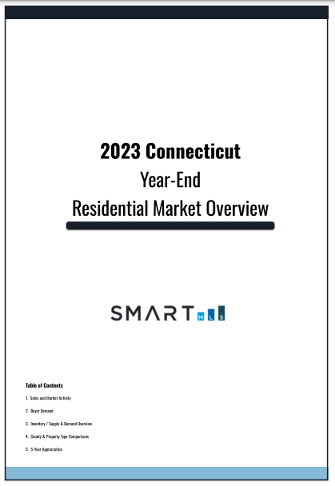
2023 Annual Reports on the Connecticut Housing Market are Here!
Analyzing statistical data on the Connecticut housing market is made easier with the use of essential tools such as SmartMLS Stats and Fast Stats.
These dynamic programs can provide you with comprehensive data, including the highly anticipated 2023 annual report.
As we move forward to 2024, these tools will continue to offer regular updates on both local and statewide market trends, ensuring you're always informed.
4

Slide 5
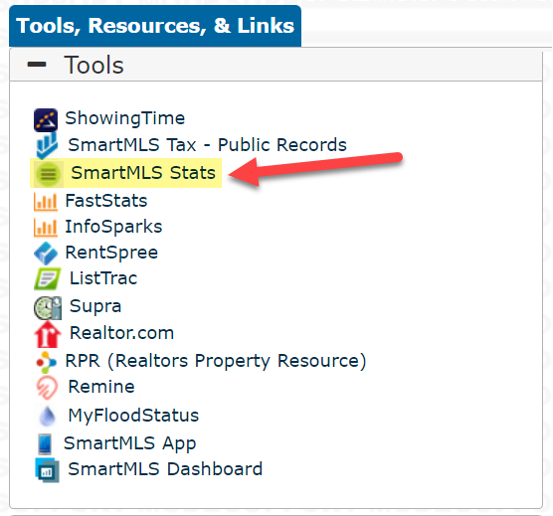
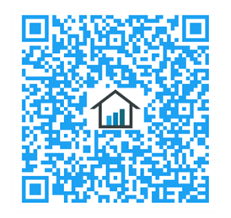
Our NEW SmartMLS Stats program provides annual and monthly analytical reports for a comprehensive understanding of the real estate industry in Connecticut.
Our release of the 2023 Connecticut housing summary report specifies:
Counties with the strongest buyer demand.
Counties with the fastest sales.
Areas with the most competitive markets.
A Statewide 2023 summary.
To view all of this information, including the statewide summary in one dynamic PDF printout, scan the QR code or click here. For more information on how you can generate insightful reports for your market, take a look at SmartMLS Stats HERE.
Locate SmartMLS Stats under the “Tools, Resources, & Links” widget in connectMLS today!
5

Slide 6
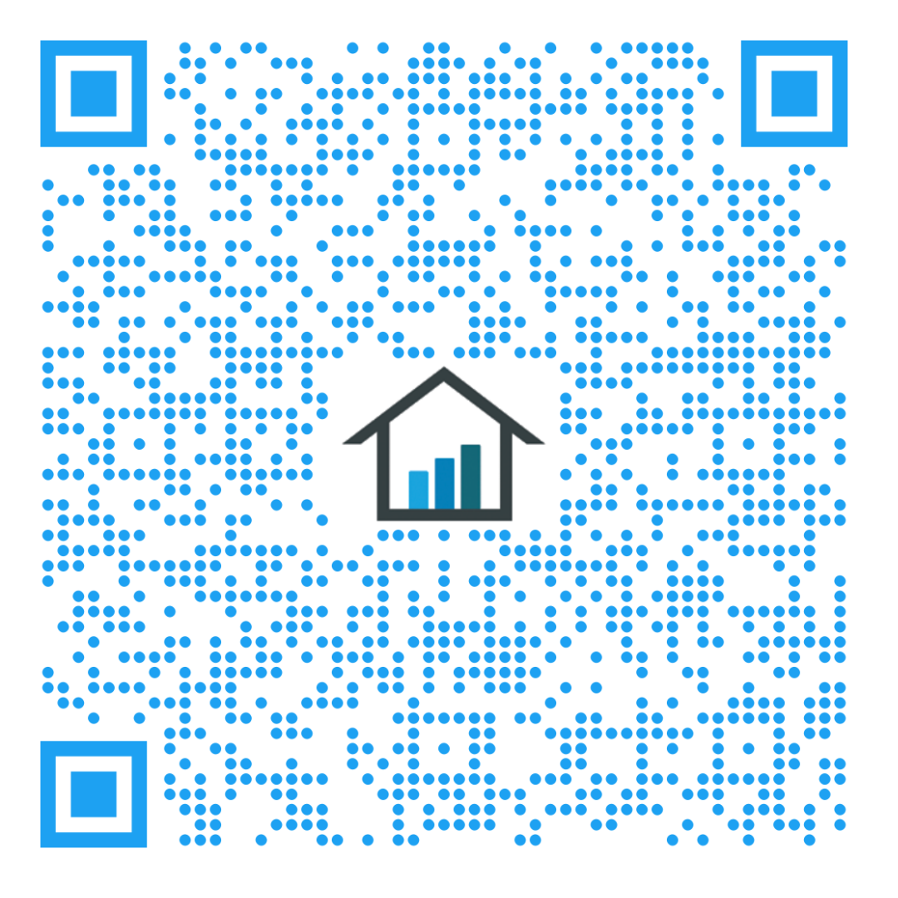
Creating Custom Market Reports is a Breeze with FastStats.
FastStats makes it possible to generate a comprehensive one-page market report tailored to your market in just a few minutes. With the interactive map, you can easily select specific metrics, including counties reports, Showingtime reports, weekly market activity, and more, and print statistics with in-depth reports.
To view all of this information, and even a statewide summary in one dynamic PDF printout, scan the QR code or click here.
Locate FastStats from the SmartMLS Homepage Today!
6

Slide 7
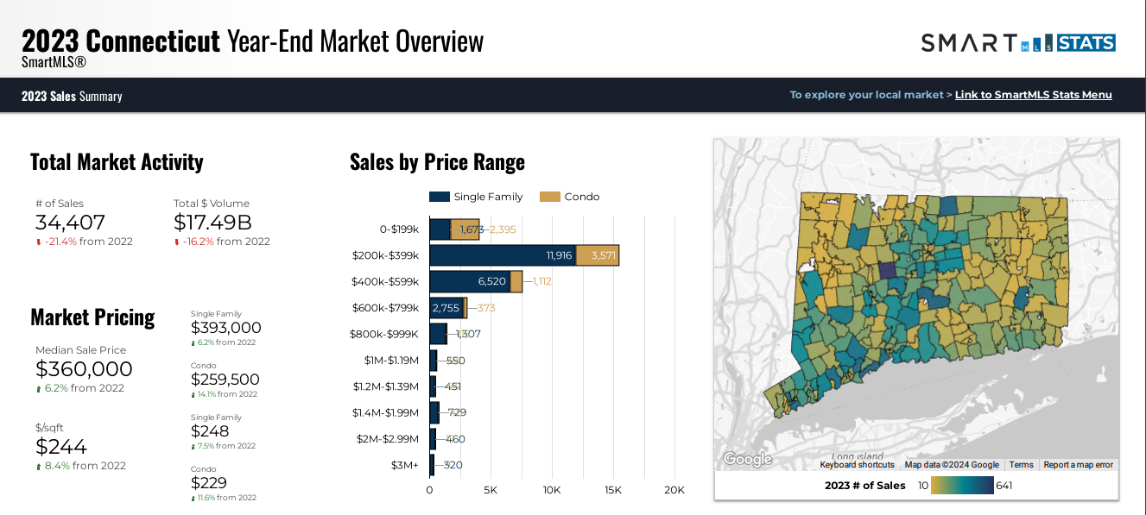
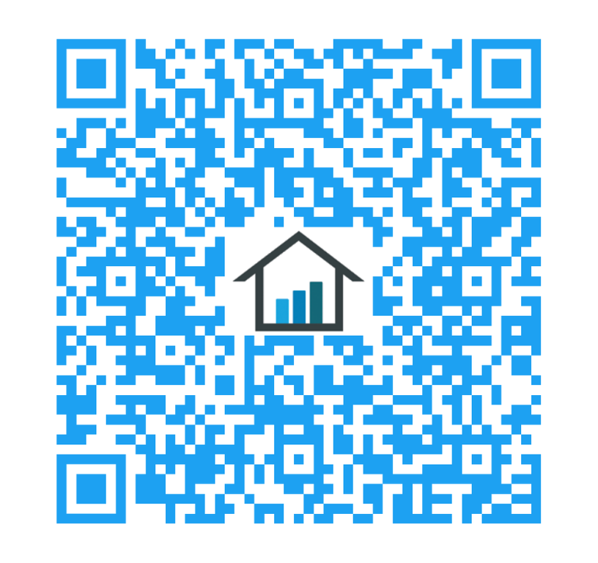
Note – This is inclusive of Residential Homes for the entire state of Connecticut.
Data current as of January 17th, 2024. Scan the code to access the full report, or click HERE.
7

Slide 8
Annual Report on the Connecticut Housing Market
Market Activity Overview
Note – This is inclusive of Residential Homes for the entire state of Connecticut.
Data current as of January 17th, 2024. Scan the code to access the full report, or click HERE.
8

Slide 9
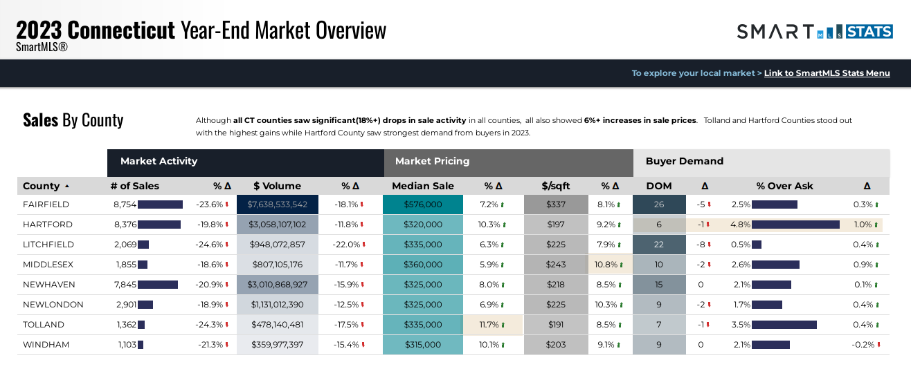
Note – This is inclusive of Residential Homes for the entire state of Connecticut.
Data current as of January 17th, 2024. Scan the code to access the full report, or click HERE.
9

Slide 10
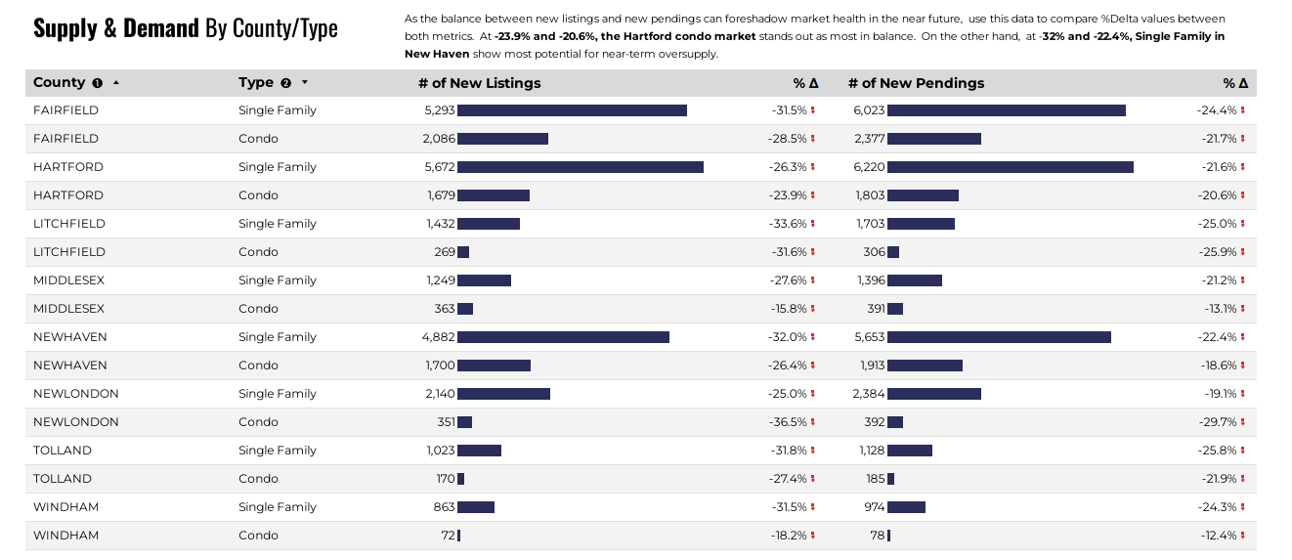
Note – This is inclusive of Residential Homes for the entire state of Connecticut.
Data current as of January 17th, 2024. Scan the code to access the full report, or click HERE.
10

Slide 11
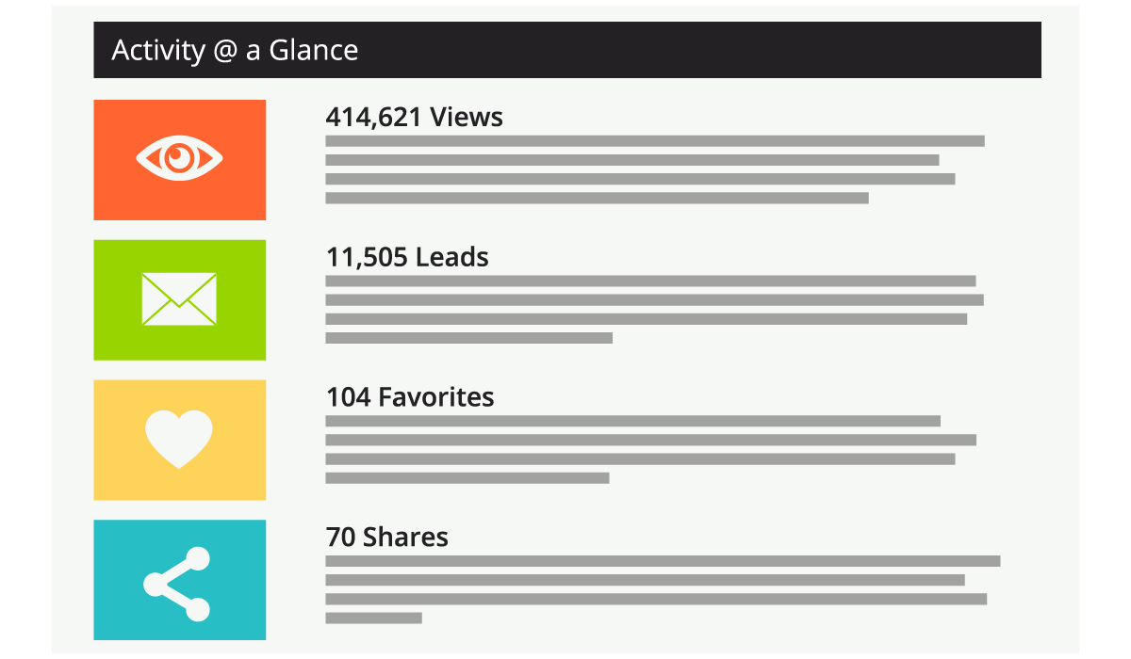
ListTrac is a tool that allows SmartMLS brokers and agents to measure the online performance of their listings.
Feature Highlights:
See a real-time view of how your listings are being viewed.
View where listings are generating the highest number of leads.
View your top performing listings at a glance.
Send your seller a well-designed, professional report to see their listing’s online performance.
ListTrac is included with your SmartMLS subscription. Access ListTrac from the member dashboard today!
11

Slide 12
connectMLS Training Course Menu
Here is a current list of our “Watch Now” Webinar classes.
Getting Started in connectMLS –
Ready to get started in connectMLS? This training session will cover everything you need to understand and use the system. Setup your business card, access the system on any device, engage with your clients and become familiar with the tools you need to get you started.
Basic Search –
This training will show you how to run a property search in connectMLS and view/share the results.
Auto-Email & The Client Portal –
This session will show you how to set up new auto emails and manage your clients by using the Saved Search Widget, Client Activity Widget and Screener functionality. The basics of the Client Portal will also be covered so you can start sharing listings with your clients.
Adding & Managing Listings –
This session will show you how locate your listings in connectMLS and how to add a new listing. You will also learn how to edit listing details and how to add photos and documents to a listing.
Getting to Know SmartMLS Tax –
This training provides an overview of our new public records program, SmartMLS Tax. SmartMLS Tax includes tools like prospecting, interactive maps and extensive property data.
CLICK HERE to access our library of Watch Now Webinars!
12

Slide 13
Need Help with Something Else?
Access our 24/7 SmartDesk HERE for answers to common questions. You can also utilize our chat feature by clicking this icon located on the bottom right corner of the SmartDesk screen.
Contact SmartMLS with assistance on Compliance, Technical Support, or Membership Questions:
203-750-6000
Support@Smartmls.com
Hours of Operation:
Monday- Thursday 8:30am-7:00pm
Friday – 8:30am – 6:00pm
Weekends – 9am – 3:00pm
13

