Slide 1
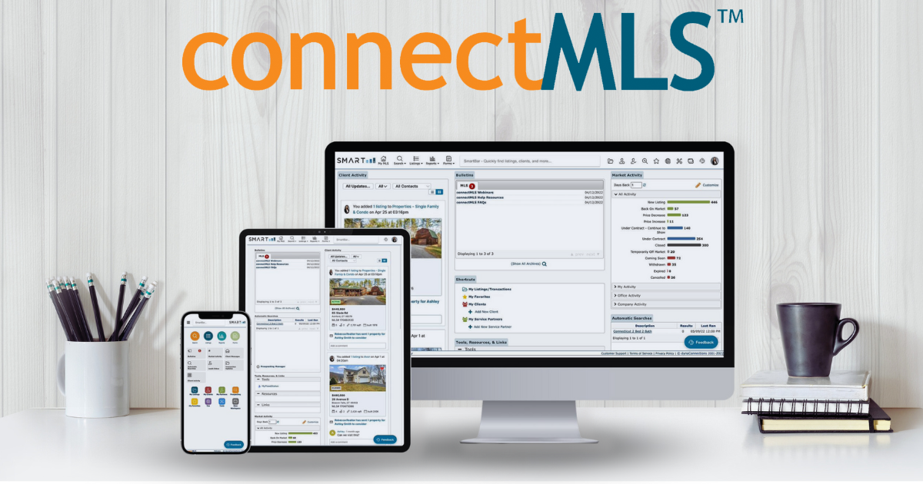
Broker Slides
Monthly Updates
March 2024

Slide 2
Table of Contents
News and Alerts – Welcome to Add/Edit
Highlights and Features
Listing Tips
Managing Your Listings
Education and Training
3-6
January Market Statistics – SmartMLS Stats
Single – Family Overview
Condo Overview
7-10
SmartMLS Updates and Resources
SmartDesk Access
Hours of Operation
11

Slide 3
Our Add/Edit system is now accessible from both connectMLS and Matrix (if you opted in). To access our new Add/Edit, simply log into connectMLS, and click on the Add/Edit icon on the toolbar.
Add/Edit Highlights:
Add or manage a listing from any device – Phone, Ipad, laptop or desktop.
Autosave capabilities between tabs allows for an easier workflow.
Create property flyers for marketing instantly.
Input only the information relevant to your listing with responsive fields.
Manage administrative access or collaborate with ease with a co-list agent.
3

Slide 4
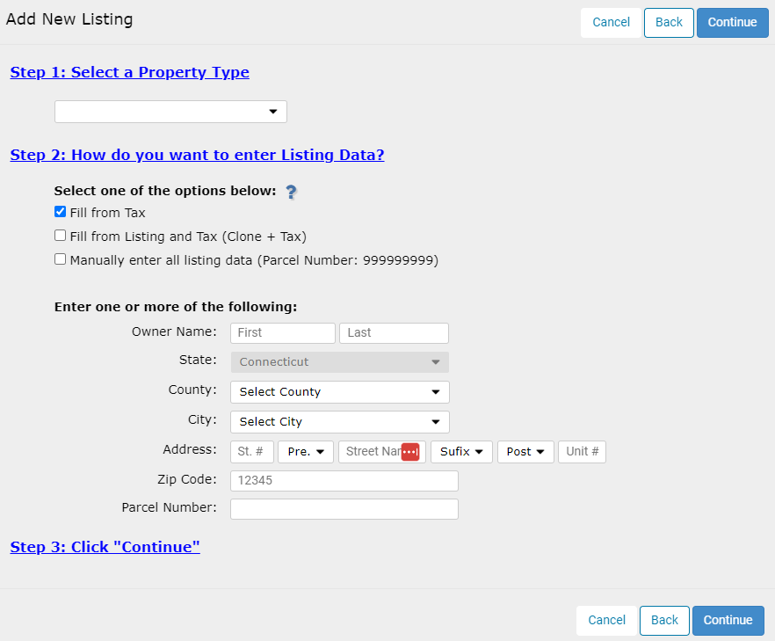
Listing Tips in Add/Edit
Your Incomplete listings, now called drafts, are waiting for you in connectMLS. To locate your drafts, follow these steps.
Locate the Add/Edit menu
Click "View Manage my Transactions"
Select "Drafts" from the upper left menu
Listing numbers will now start with "24“
You must add a separate entry (on the Rooms tab) for each bedroom in the listing, and one of them must be entered as a Primary Bedroom.
Utilize the "Generate Listing Sheet", which populates all data entered during the listing input process and backfills the data input PDF. You can then upload the document to TransactionDesk and present it to your client.
Click here to watch a quick video on how to generate a listing sheet.
4

Slide 5
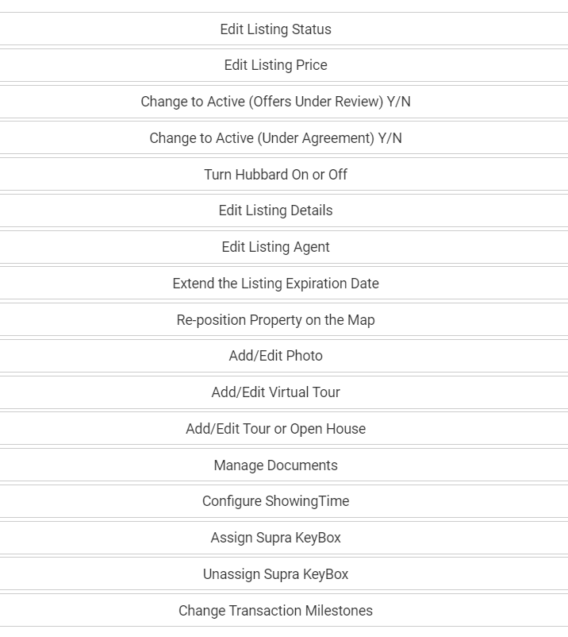
Managing Your Listings in connectMLS
Editing an Active Listing
If you have an active listing that needs to be updated, please follow the below steps to access the "edit a listing" menu.
1. Navigate to the Add/ Edit menu.
2. Click “View Manage My Listings & Transactions”.
3. Locate the drop-down menus located on the upper left corner of your screen and select the appropriate status.
4. Locate the listing you wish to edit and click on the pencil icon.
Click here to get more detailed information on how to edit an active listing in connectMLS.
5

Slide 6
Add/Edit Training and Education
Everything you need to master Adding and Managing Listings can be found here, including short video tutorials, knowledgebase articles, and a link to on-demand training.
Short Tutorial Videos: How to Add a Listing in connectMLS How to Edit a Listing in connectMLS How to Add Photos to Your Listing How to Add Documents to Your Listing How to Generate A Listing Sheet
Written Articles With Step-by-Step Instructions: How to Add a Listing in connectMLS Add/Edit Menu Overview How to Add a Tour or Open House to Your Listing How to Add Documents to Your Listing
On -Demand Training: Adding and Managing Listings in connectMLS
Live Training Schedule: SmartMLS Live Training Calendar
CLICK HERE to access our entire library of Watch Now Webinars!
6

Slide 7
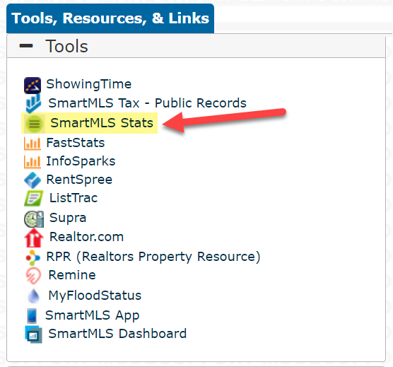
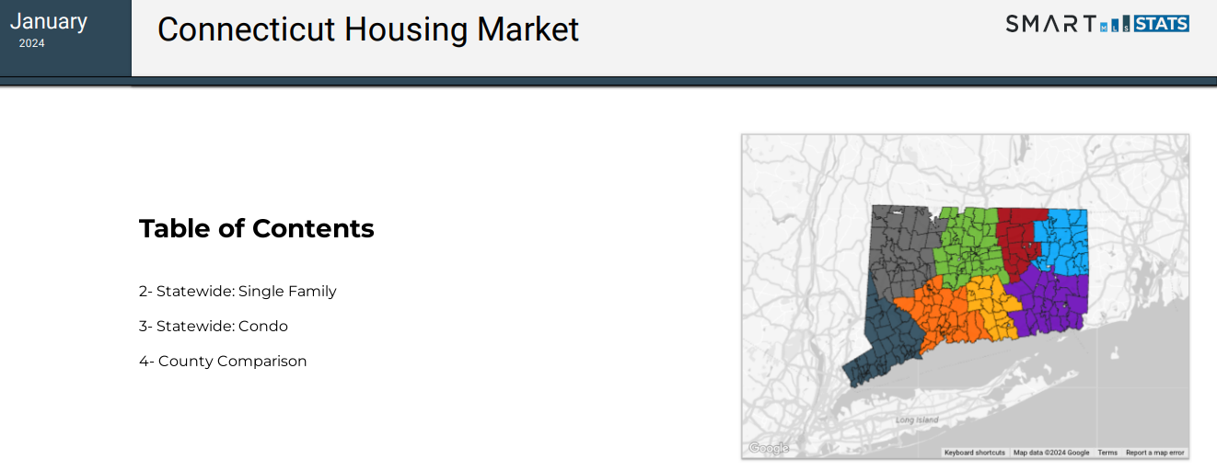
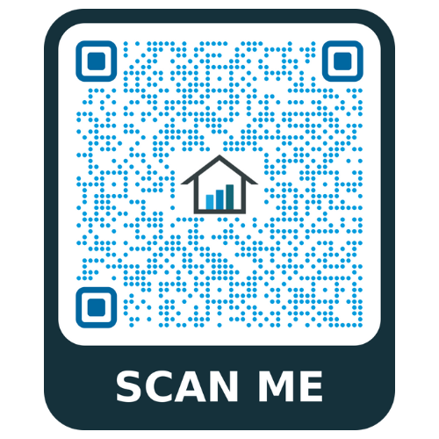
Our NEW SmartMLS Stats program provides annual and monthly analytical reports for a comprehensive understanding of the real estate industry in Connecticut.
To view the January 2024 Summary, including a comparison by county in one dynamic PDF printout, scan the QR code or click here.
For more information on how you can generate insightful reports for your market, look at SmartMLS Stats HERE.
Locate SmartMLS Stats under the “Tools, Resources, & Links” widget in connectMLS today!
7

Slide 8
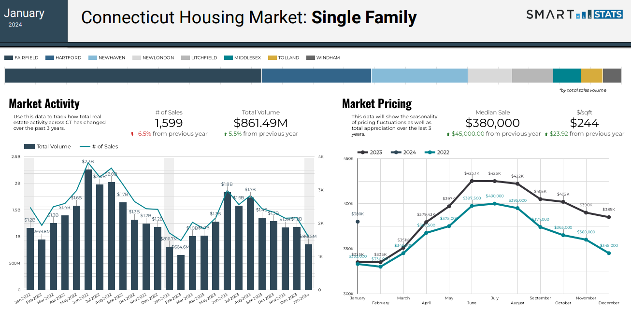
Note – This is inclusive of Residential Homes for the entire state of Connecticut.
Data current as of February 5th, 2024. Scan the code to access the full report, or click HERE.
8

Slide 9
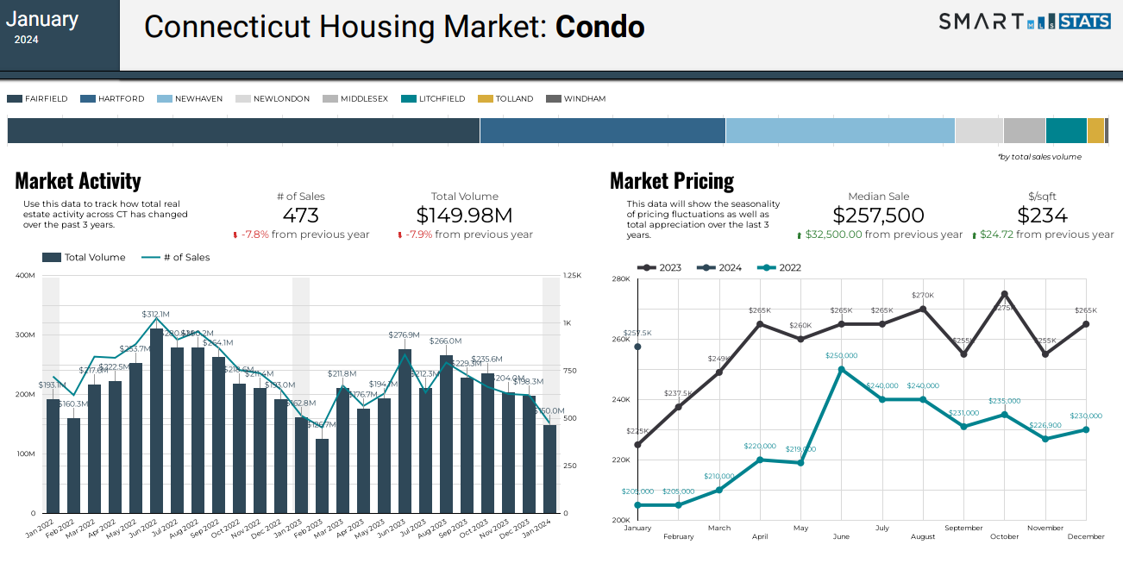
Note – This is inclusive of Residential Homes for the entire state of Connecticut.
Data current as of February 5th, 2024. Scan the code to access the full report, or click HERE.
9

Slide 10
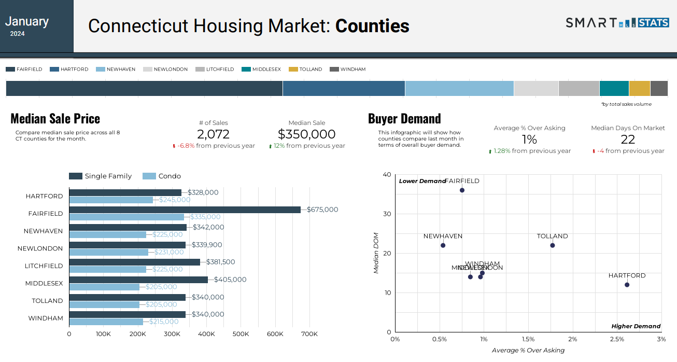
10
Note – This is inclusive of Residential Homes for the entire state of Connecticut. Data current as of February 5th, 2024. Scan the code to access the full report, or click HERE.

Slide 11
Need Help with Something Else?
Access our 24/7 SmartDesk HERE for answers to common questions. You can also utilize our chat feature by clicking this icon located on the bottom right corner of the SmartDesk screen.
Contact SmartMLS with assistance on Compliance, Technical Support, or Membership Questions:
203-750-6000
Support@Smartmls.com
Hours of Operation:
Monday- Thursday 8:30am-7:00pm
Friday – 8:30am – 6:00pm
Weekends – 9am – 3:00pm
11

